Slide 1
Maximizing Veteran Success: Leveraging Financial Aid with VA Education Benefits
Sherlock G. McDougald
Dean of Enrollment Management & Financial Aid
Edgecombe Community College
Notes:
Introduce yourself, your role, and your experience working with both Financial Aid and VA education benefits. Explain that the goal of this session is to help SCOs and veteran service staff better understand how financial aid can complement VA benefits to support student veterans.

Slide 2
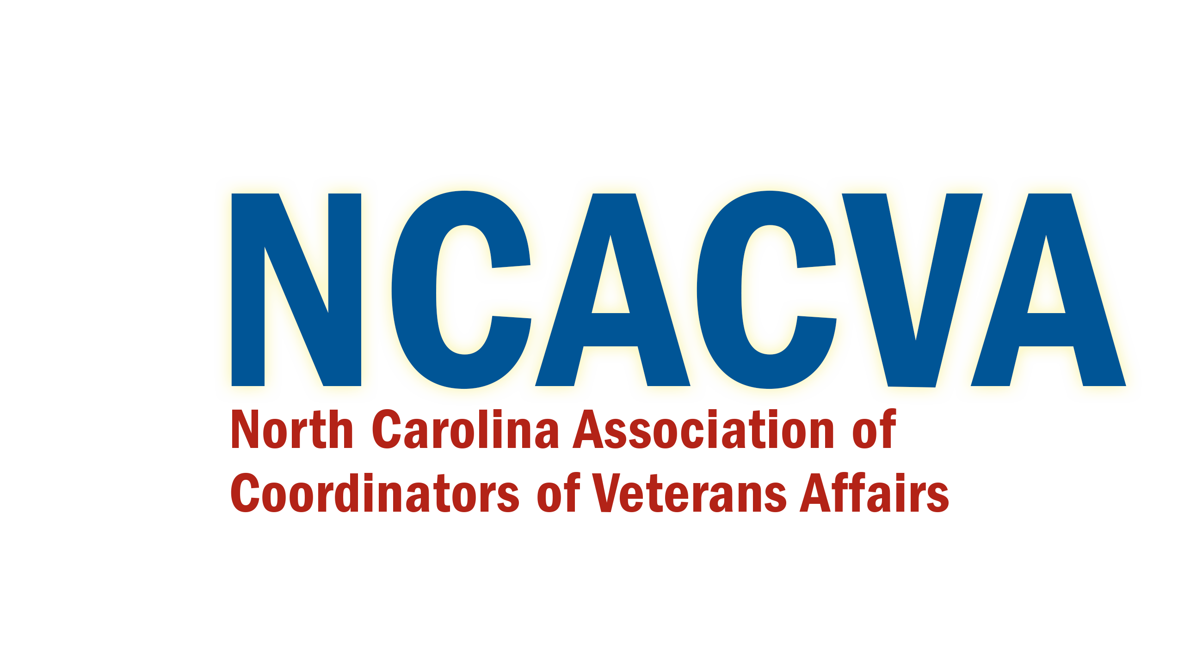
Session Overview
• Importance of coordinating VA benefits with financial aid
• Understanding federal aid programs
• Federal aid limits (Pell, SEOG, FWS)
• Strategies to maximize support for veterans
Notes:
Briefly explain what participants will learn and how this session will help them better support veteran students on their campuses.

Slide 3
Why This Conversation Matters
• Many veterans rely only on VA benefits
• FAFSA completion among veterans can be low
• Financial aid can cover additional costs
• Coordination improves student success
Notes:
Explain that many veterans believe the GI Bill covers everything. In reality, financial aid can significantly expand their resources and reduce financial stress.

Slide 4
Understanding Our Student Veterans
• Often older than traditional students
• May support families
• Many work while attending school
• Some have service-related disabilities
Notes:
Discuss how veterans often juggle multiple responsibilities and why maximizing financial support is essential.

Slide 5
Overview of VA Education Benefits
• Post‑9/11 GI Bill (Chapter 33)
• Montgomery GI Bill (Chapter 30)
• Dependents' Educational Assistance (Chapter 35)
• Veteran Readiness & Employment (Chapter 31)
Notes:
Explain the major VA programs most SCOs encounter and briefly describe what each program typically covers.

Slide 6
What Components are covered By VA benefits
• Tuition & fee coverage (varies by chapter)
• Monthly housing allowance
• Book stipends
• Additional support programs
Notes:
Highlight that while these benefits are valuable, they do not always cover all student expenses.

Slide 7
Common Veteran Misconceptions
• FAFSA is not necessary if using VA education benefits
• Veterans will not qualify for grants or scholarships
• Income makes them ineligible
• Financial aid reduces VA benefits
Notes:
Explain that these misconceptions frequently prevent veterans from accessing additional funding.

Slide 8
Financial Aid Overview
The Free Application for Federal Student Aid (FAFSA) is an important step for veterans because it unlocks access to additional financial resources beyond VA education benefits.
Student may be eligible for the following:
• Federal Pell Grant
Federal Supplemental Educational Opportunity Grant (FSEOG)
• Federal Work‑Study (FWS)
• State grants (Next NC Scholarship)
• Institutional scholarships
Notes:
Introduce the main financial aid programs that veterans may qualify for.

Slide 9
FAFSA and Veteran Status
• Veterans are automatically independent students
• No parental information required
• Many qualify for Pell Grants
Notes:
Explain that veteran status simplifies FAFSA completion and often increases eligibility.

Slide 10
Federal Pell Grant
• Maximum award approx. $7,395 (2025‑26)
• Based on Student Aid Index
• Enrollment status affects award
• Lifetime eligibility: 600%
Notes:
Explain how Pell works and emphasize the lifetime eligibility limit equivalent to about six full‑time years.

Slide 11
Federal SEOG
• Campus‑based aid program
• Awards typically $100–$4,000
• Priority given to students with exceptional need
• Limited institutional funding
Notes:
Explain that SEOG is limited funding and early FAFSA completion is critical.

Slide 12
Federal Work‑Study
• Provides part‑time employment
• Typical awards $1,500–$5,000
• Paid as wages
• Helps reduce reliance on loans
Notes:
Explain how work‑study provides income rather than direct tuition coverage.

Slide 13
Key Regulatory Note
FAFSA Completion (Title IV Eligibility)
  Veterans are considered independent students
  May qualify for Pell Grant (up to annual federal limits)
  Eligible for FSEOG and Federal Work-Study (FWS)
Post-9/11 GI Bill is NOT counted as Estimated Financial Assistance (EFA)
  Does not reduce Pell eligibility
  Allows for maximum aid packaging
VA Benefits ARE counted as EFA for Campus-Based Aid
  May Impacts:
    FSEOG
    Federal Work-Study
  Must be included in need calculation
Notes:
Explain that VA benefits generally do not reduce federal grant eligibility, allowing veterans to receive both.

Slide 14
Key Regulatory Note
Cost of Attendance (COA) Adjustments
SCOs and FA offices can adjust COA for:
  Books/supplies
  Housing costs
  Required equipment
Return of Title IV Funds (R2T4)
Applies when a student withdraws before 60%
VA and Title IV are separate processes
Both may require adjustments
Satisfactory Academic Progress (SAP)
Many schools align SAP and VA progress policies for administrative consistency
Overpayments & Debt Management
VA debts handled through VA
Title IV overpayments handled through ED
Must counsel students on both

Slide 15
Stacking Benefits
Veterans may receive:
• VA education benefits
• Pell Grant
• SEOG
• Work‑Study
• Scholarships
Notes:
Explain the concept of stacking aid sources to create a comprehensive financial support package.

Slide 16
Example Funding Package
Tuition and Fees $1025
Award Type Award Amount
VA benefits $1025
Pell Grant $3,697
Scholarship: $1,000
Total Award: $5697
Student’s T&F is covered by VA education benefits therefore student will be eligible for a refund to assist with other living expenses.
Notes:
Walk through a practical example to illustrate how aid can exceed tuition and help cover living expenses.

Slide 17
Why This Supports Retention?
• Financial stability improves persistence
• Reduces stress for student veterans
• Allows focus on academics
Notes:
Discuss the connection between financial support and student success outcomes.

Slide 18
Institutional Collaboration
• Financial Aid Office
• Veterans Affairs Office
• Advising
• Business Office
Notes:
Explain that collaboration across departments is essential for veteran success.

Slide 19
Best Practices for SCOs
• Encourage FAFSA completion
• Educate veterans about grants
• Connect students with financial aid advisors
• Promote scholarships
Notes:
Provide actionable recommendations SCOs can implement immediately.

Slide 20
Key Takeaways
• VA benefits and financial aid work together
• FAFSA is essential for veterans
• Collaboration improves outcomes
• Grants reduce student debt
Notes:
Summarize the major lessons from the presentation.

Slide 21
Discussion
What is the biggest misconception veterans have about financial aid on your campus?
How do you inform students about financial aid?
Notes:
Invite audience participation and encourage sharing experiences.

Slide 22

Questions and Contact Information
Sherlock McDougald
Edgecombe Community College
252.618.6534
mcdougalds@edgecombe.edu
Notes:
Thank participants and invite questions from the audience.

