Slide 1
UNC System Update
NCACVA Spring Conference March 2026

Slide 2
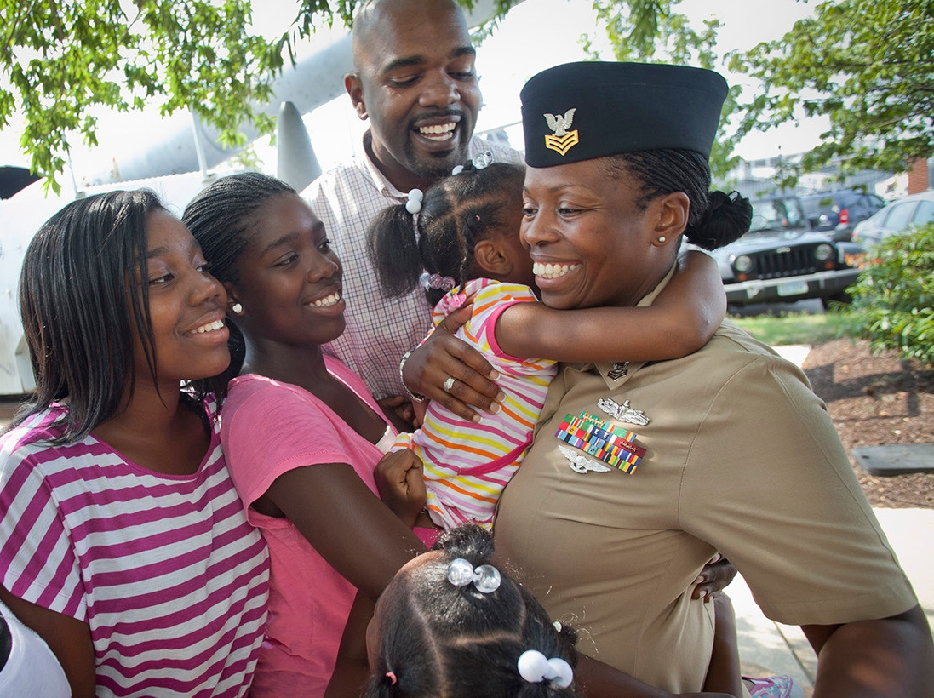
Overview
The Importance of the Military-Affiliated Community in NC
Initiatives to Support Military-Affiliated Students
(UNC System Office and State Legislation)
Considering the Needs of Military-
Affiliated Learners
What Can You Do to Help?

Slide 3
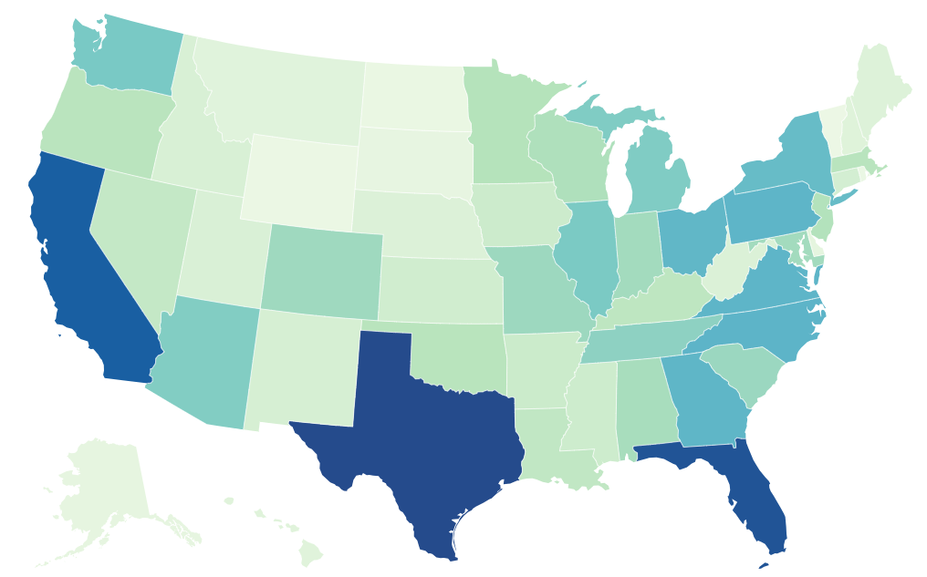
Military Importance in North Carolina
North Carolina Ranks 4th in the nation for both number of active-duty service members and veterans.
Currently, there are apx. 138,000 active-duty personnel and 615,000 Veterans living in NC.
The US Military has an $80 billion impact on NC Economy
Active-duty is data based on June 2024 military personnel report by The Defense Manpower Data Center.
Veteran data is based on data from the US Census Bureau’s 2023 American Community Survey

Slide 4







Military Importance in North Carolina
#2
Economic Ranking of Defense Sector
#12
US Ranking for Defense Spending ($12.5B, FY2023)
A Robust Military Ecosystem in NC (list not exhaustive)
~15%
NC Legislators with military experience
Source: NC Military Affairs Commission; US DoD Office of Local Defense Cooperation; NC General Assembly Office of the House Principal Clerk

Slide 5


The University of North Carolina System
The UNC System is the governing and policy-making body for all public universities in the state of North Carolina.
Currently, there are apx. 23,000 military-affiliated students attending UNC System Schools.
Fall 2025 Military-Affiliated Student Enrollment – 23.521
(Up from 22,462 in fall 2024)
Post-911 and DoD Tuition Assistance - $56.6M for AY24-25
(Up from 53.7M in fall 2023)

Slide 6

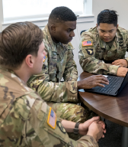
UNC System Military-affiliated Enrollment Trends
UNC System Strategic Goal:
Military Enrollment
UNC System Military-Affiliated Enrollment
Fall 2020-2025
20.5K
Baseline Enrollment (2021)
23.2K
Current Enrollment (2025)¹
25.0K
Target Enrollment (2027)
13%
6%
v.
5-yr Military Affiliated Enrollment Growth
(2020-2025)
5-yr UNC System Overall Enrollment Growth
(2020-2025)
Notes: (1) Includes active military, veterans, spouses and dependents; (2) Fall 2025 enrollment data reflects census data (instead of end-of-term enrollment data). Therefore, Fall 2025 enrollment figures subject to change.
Notes:
This is what was presented to the BOG in April. This was great news. But then…..

Slide 7
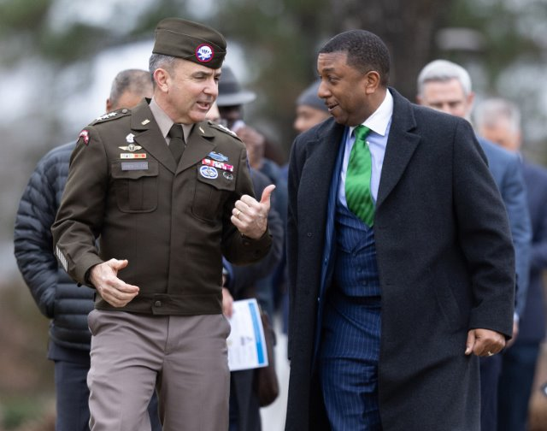
UNC System Initiatives: Serving Military Affiliated Students
Making Our System More Military Friendly
Strategic partnerships between campuses and NC military installations
Policies that encourage applicants to choose our schools
Chancellor Darrell Allison and Lieutenant General Gregory Anderson at the signing of FSU’s official Education Partnership with the XVII Airborne Corps
Notes:
Update the update with project status, total numbers

Slide 8
UNC System Initiatives: Military Student Success Regulation
UNC System Regulation: 700.7.1
Codifies key terms “Military Student” and “Military–Affiliated Student”
Ensures equity among Military and Military-Affiliated Students by updating policies around application fees and priority registration
Per UNC System Regulation 700.7.1:
The term “military student” shall mean any student who is a veteran or actively serving member of the United States Uniformed Services as defined in 37 U.S.C.§101(3), a member of the military reserves, or a member of the National Guard.
The term “military-affiliated student” shall include both “military student” as defined above and any student who is the spouse, child, surviving spouse, or surviving child of a “military student” as defined above, as well as any student who is a Reserve Officers' Training Corps (ROTC) cadet.

Slide 9




UNC System Initiatives: Serving Military Affiliated Students
Ensuring consistent support and resources
Hosting monthly meetings with staff who work with military-affiliated students.
Educating staff about the specific needs of military-affiliated students
Mental health and suicide prevention training
Notes:
Theme = Serving Our NC Military Family (Inst. Initiatives)

Slide 10
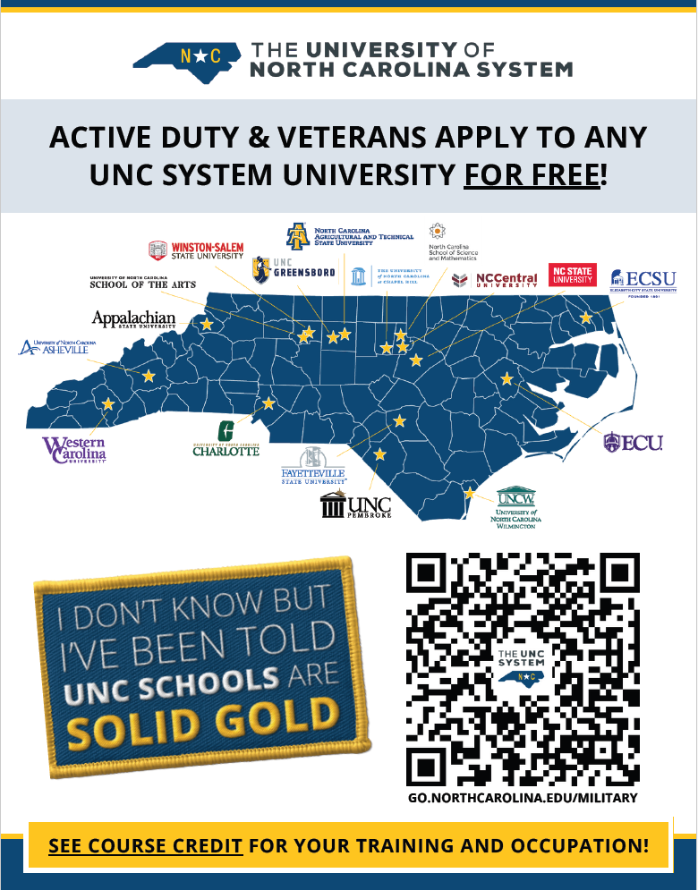

UNC System Initiatives: Outreach
Military Affairs Flyer and Student Portal
Flyer QR Code directs potential students to the newly redesigned military-affiliated student site: northcarolina.edu/students/military
The new student site contains info about academic programs, credit for military training and experience, support resources, and contact information for campus staff who work with military-affiliated students.

Slide 11


UNC System Initiatives: Outreach
Military Affairs Partner Website
In partnership with our Communications team, our team launched the newly redesigned UNC System military-affairs site: northcarolina.edu/military
The new site contains info about credit for military training and experience, external partnership opportunities, and training resources for faculty and staff who want to learn more about military-affiliated students.

Slide 12
UNC System Initiatives: Military Equivalency System
May 2022
Military credit policy regulation signed by President Hans
August 2022
MES project start
March 2024
Phase II complete: Public portal launched 5,000 equivalencies
June 2023
Phase I complete: Internal infrastructure
Spring 2024-Now
Worked with UNC institutions to enter equivalencies
January 2025
ACE data exchange pilot complete
April 2025
17,000 equivalencies
Workforce aligned nursing equivalencies captured
July 2025
Administrative Portal and JST Upload Feature launched
Today and Beyond
Convening additional faculty panels
Launching student appeals portal
22,000 equivalencies
12

Slide 13
State Initiatives: SENATE BILL 118
Offers In-state tuition for certain honorably discharged veterans
 | IN-STATE TUITION FOR CERTAIN VETS
Description | Grants in-state tuition to certain honorably discharged veterans.
Eligibility | To qualify an individual must meet all following criteria: served active duty for at least 90 days in Armed Forces; AND received honorable discharge; AND Meet one of the following criteria Graduated from high school in NC on or after 1/1/2004; OR Served active duty in Armed Forces with a perm station in NC for at least 90 continuous days; OR Was awarded a Purple Heart
Bill # | SB118 (enacted 07/09/2025)
Effective Date | AY 2025-2026
Misc Comments | (1) Legislation indicates burden of proof is on individual applying for the benefit to prove entitlement of the benefit

Slide 14

Considering the Needs of Military-Affiliated Students

Slide 15
Considering the Needs of Military-Affiliated Students
Transition Difficulties:
Students may have difficulty translating their military skills into a new direction.
Credits from schools with varying accreditation
Joint Services Transcript Articulation
Veteran students are more likely to have their own families than traditional students.
Veterans are more likely than traditional students to have jobs outside of school that limit the amount of time they can spend on coursework and co-curricular activities.
Logistics:

Slide 16
Considering the Needs of Military-Affiliated Students
Transition Difficulties:
Students may have difficulty translating their military skills into a new direction.
Credits with varying accreditation
Joint Services Transcript Articulation
Military Students are more likely to have their own families than traditional students.
Military Students and Spouses are more likely than traditional students to have full-time jobs outside of school that limit the amount of time they can spend on coursework and co-curricular activities.
Logistics:

Slide 17
Considering the Needs of Military-Affiliated Students
Transition Difficulties:
Military Students and Spouses are more likely to be non-traditional aged student and express difficulty connecting with younger students in class.
Military Students and Spouses are more likely to live off-campus and feel disconnected with campus life.
Some students have expressed a feeling of insensitivity from classmates, faculty, and others on campus regarding discussion of war and military.
Culture:

Slide 18
Considering the Needs of Military-Affiliated Students
Transition Difficulties:
Mental health challenges: PTSD, Hypervigilance, and TBIs (TBIs are technically physical conditions, but can have similar symptoms)
Physical disabilities: As of the end of OIF and OEF, over 770,000 service members transitioned to veteran status with a disability rating.
Substance Use: In the wars in Iraq and Afghanistan, about 1 in 10 returning soldiers seen by the VA have a problem with alcohol or other drugs. More than 2 of 10 Veterans with PTSD also have SUD
Wellness:

Slide 19
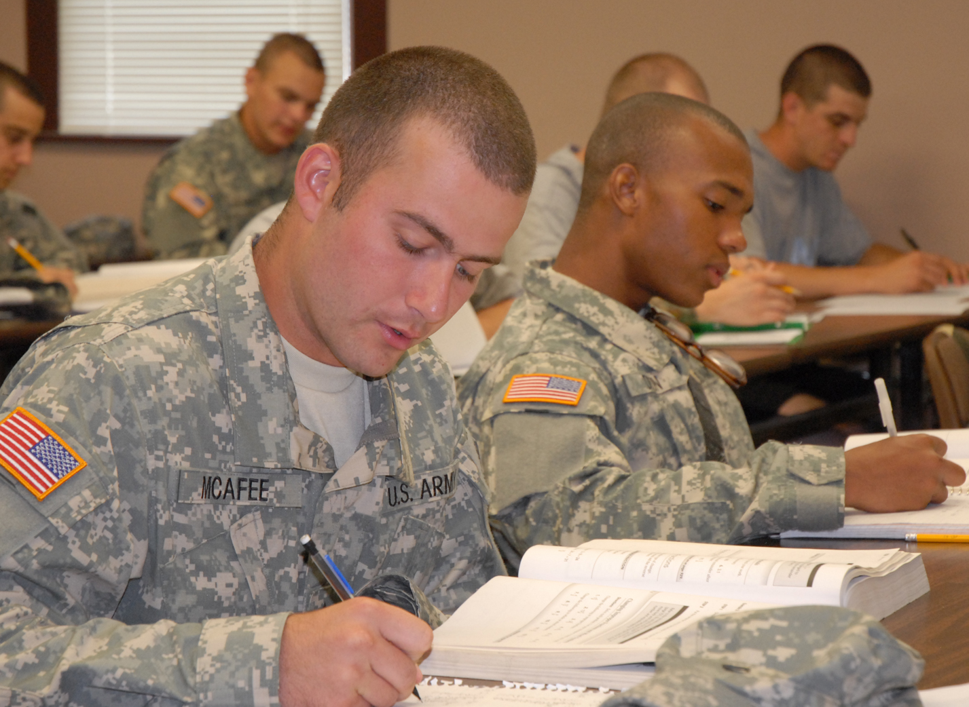
Considering the Needs of Military-Affiliated Students
Transition Difficulties: Areas for Improvement
Trouble with self-directed learning
Difficulty with classroom dynamics and teaching styles
Study skills not honed
Lack of feedback
Decentralized services
Triggering subject material
Coping with wounds of war
Challenges asking for help

Slide 20

Considering the Needs of Military-Affiliated Students
Transition Strengths:
Military Students bring a unique perspective
Resourcefulness/resilience
Life experience/established identities
Leadership experience
Cultural awareness
Skills taught in the military
Time Management
Discipline
Work Ethic
Teamwork

Slide 21
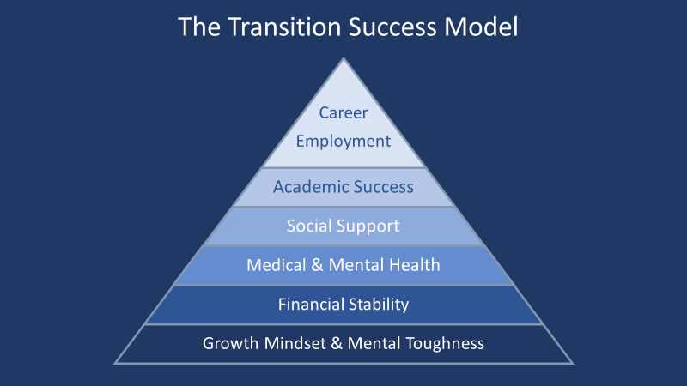
Considering the Needs of Military-Affiliated Students
Hierarchy of Needs (Student Veterans Edition)
*Provided by the University of Massachusetts Lowell Veterans Services Office

Slide 22
Considering the Needs of Military-Affiliated Students
Meet a life goal, support themselves and their family, establish new identity
Not used to asking for help, not wanting to appear weak, demands of VA benefits programs
Starting over in a new environment, exploring new personal and professional identities
Service-connected illness or injury (PTSD/TBI), No experience managing their own healthcare
Major loss of income upon exiting the military, financial responsibilities (childcare, mortgage, etc)
College environment is very different from military, several changes happening at once (transitioning from military to civilian to student)
22

Slide 23

What Can You Do to Help?
Learn what support resources are available on your campus
Veterans Center/Military-Affiliated Services
Accessibility Resources and Services
Academic Advising/Student Success
Learning Centers
School Certifying Officials (GI Bill Benefits)
Student Veterans of America
Dean of Students
Leadership/Civic Engagement Offices
Athletics/Recreation
Counseling/Recovery Centers
Intercultural Engagement

Slide 24
What Can You Do to Help?
Build Understanding
Who are YOU as a communicator?
What are your tendencies?
Who are you speaking with?
What are their tendencies?
(Remember, individuals are not their culture!)
How can you make connections that are meaningful?
Build Skills
Self-monitoring
Active listening
Effective goal setting
Reflection that informs communication
Practice, practice, practice!

Slide 25
What Can You Do to Help?
What student veterans want faculty and staff to know:
Student veterans are a unique population with different experience than traditional students.
There are numerous ways to help student veterans just as there are for other populations.
Developing trust with this population is important.
Never assume that you know a veteran’s politics or beliefs.
Veterans may not want to be thanked for their service.
Following-up with the student veterans and carrying out what you say you will do is essential.
Veterans are accustomed to self-reliance and may not ask for help.

Slide 26
What Can You Do to Help?
Engaging in Dialogue:
How has your experience at the university been?
How do you feel your past experiences are positively/negatively affecting your studies?
Do you feel like you are missing out on any information or college experiences as a non-traditional student?
What was your favorite part about being in the military?
What do you value from your military experiences?
NEVER ask if a service member has killed someone.
NEVER ask if a service member has lost someone.
NEVER ask if or how a service member was injured.
NEVER assume to know their experiences.

Slide 27
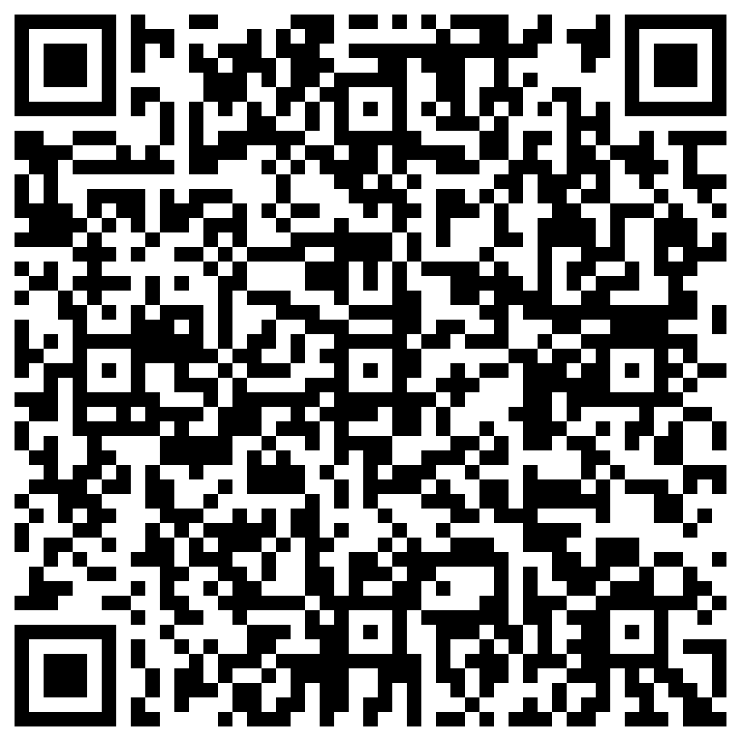
UNC System Office: Questions?
Bradley Wrenn
Program Manager for Military and Veterans Education
UNC System Office
www.northcarolina.edu/students/military
btwrenn@northcarolina.edu
Brad’s Contact Info
Notes:
Update the update with project status, total numbers

