Slide 1

VA Debt Management Center (DMC)
School Certifying Official Training
Updated March 2026

Slide 2
Agenda
DMC overview
Digital GI Bill (DGIB) Transition Updates
Debt establishment
Understand collection processes
Debt resolution options
Risks of non-payment
Questions

Slide 3
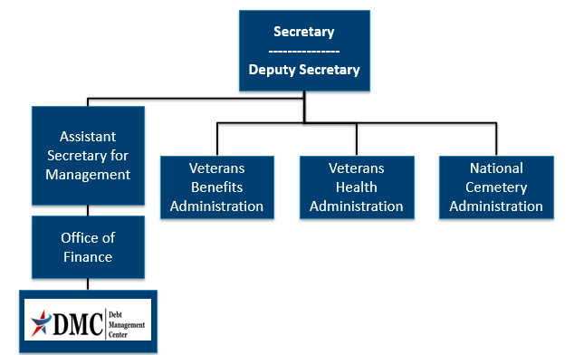
Organization Chart

Slide 4
DMC Mission
Provide distinctive, high quality accounts receivable services through a compassionate and value-added approach, empowering our stakeholders to focus on core missions.

Slide 5
DGIB Updates: DMC Systems
Remaining school debt issues related to TOE students resolved
Work around is available for most instances of debts showing in VBA system but not in DMC system
Some fixes are still pending- suspended debts will still appear on debt lists but are not being collected
Most debt issues still pending resolution involve debts not displaying for the correct facility code in the DMC system
  We are unable to issue debt letters when this is the case

Slide 6
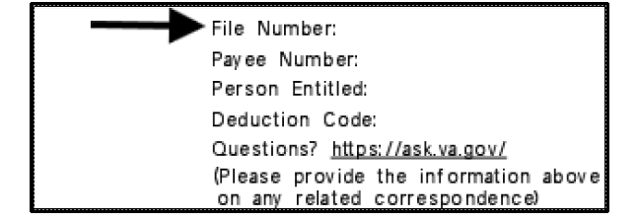
Update to Education Debt Identification
DMC has transitioned from using VA File Number or SSN to a debt specific Receivable ID (RID) to improve security
The RID is displayed on education debt letters in the file number field at the top right. You will know it is the RID if the entire number is visible (file numbers only showed the last four digits when displayed in this space).

Slide 7
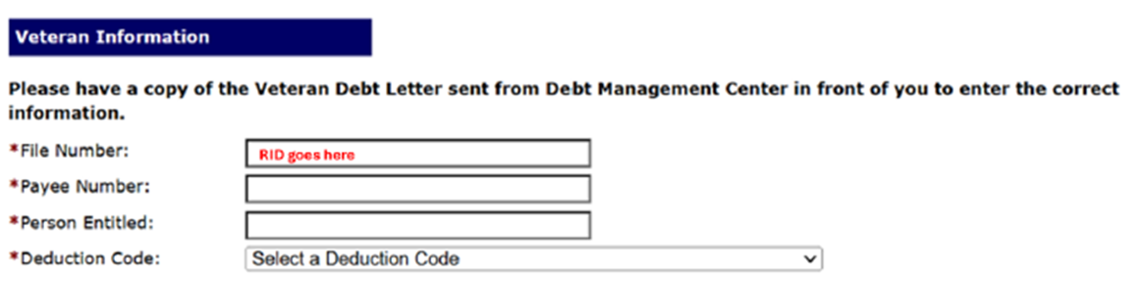
RID and Pay.va.gov
Receivable ID is required instead of File number on pay.va.gov for all education debts
Pay.va.gov still looks the same, however RID will go in place of the file number for education debts
If a debtor has multiple EDU debts, they must make individual payments per RID

Slide 8
Additional RID Reminders
If a school needs assistance identifying their Receivable IDs for debts:
  Request a debt list by facility code in AVA (now includes RIDs)
Student debts for books, tuition, Chapter 30, 1606, and Chapter 35 payments are also identified by RID
DMC recommends including the RID on all correspondence and payments:
  Ask VA (AVA) inquiries
  Check payments (stub contains RID but suggested to put RID on checks)
  Students should include RID when submitting VA Form 5655 Financial Status Report (FSR) or other documents to DMC

Slide 9
Debt Establishment
SCO Certifies Student
Regional Processing Office (RPO) Processes Certifications
DMC Collects Debts
Sends collection letters for debts
Sends a letter when payments are issued or debt created
Processes collection actions
Evaluates entitlement
Issues payments and establishes debts
Communicates with student about certification process

Slide 10
Debt Establishment
Post 9/11 GI Bill Benefits
Tuition/Fees/Yellow Ribbon
School Debt
Books and Supplies
Student Debt
Housing Stipend/ Kicker
Student debt

Slide 11
Debt Establishment Reasons
Student never attended any classes (All T/F/YR)
Payment for wrong student or duplicate payment
(Erroneous amount)
Reporting reduced T/F/YR amount, no change to training
(Amount of $ change )
Payment above certified amount due to VA data entry error
(Erroneous amount)
Student dropped/added a course, no net change in training time
(Amount of $ change )
Student completely withdrew on or before first day of term
(All T/F/YR)

Slide 12
Debt Establishment Reasons
Student withdrew after first day of term
Student reduced hours before or during term
School reported reduction in T/F/YR due to student reducing or terminating training

Slide 13
Debt Establishment Reasons
Action | Condition | Will Be Effective
Reduction | During Drop Period | End of month the reduction occurred
Termination | During Drop Period | Actual date of withdrawal
Reduction | Punitive Grade assigned | End of month the reduction occurred
Termination | Punitive Grade assigned | Actual date of withdrawal
Reduction or Termination | Non- Punitive grade assigned | First day of the Term
Reduction | Non- Punitive grade AND Mitigating Circumstances (MITCs) | End of month the reduction occurred
Termination | Non- Punitive grade AND Mitigating Circumstances (MITCs) | Actual date of withdrawal

Slide 14
School Debt Example
SCO certifies term 08/28/2024 – 12/16/2024, T&F $10,000.00 (for credits)
VA pays $10,000.00 for the 08/28/2024 – 12/16/2024 term
School reported a change to tuition and fees with no change to credits, the new tuition and fees reported was $5000
Student then reduced training effective November 15th with punitive grades and new tuition and fees amount is $2500
How would you calculate this debt?

Slide 15
School Debt Example continued
School Debt Calculation
Amount due for term is $4633.03
  ($5000/109 days in the term x 93 days attended at this rate= $4266.06) plus
  ($2500/109 days in the term x 16 days attended at this rate =$366.97)
$10,000 paid - $4633.03 due = Debt of $5366.97

Slide 16
Preventing School Debts
Educate students about impact:
Reducing Training
Changing class schedule
When
non-punitive
grades occur
School can include mitigating circumstances on certification
Student can submit mitigating circumstances to RPO
Certify $0 tuition/fees before term begins
Allows student to receive books and housing on time
Non-punitive grades
Certify T/F/YR amount at a later date

Slide 17
School Debt Collection Process
DMC sends Notice of Indebtedness letters, monitors accounts, and advises debtor of any delinquency, including the requirement to refer their account to Treasury
If DMC receives payment,
next collection letter is deferred
DMC Sends 1st Letter
30 days
DMC Sends 2nd Letter
30 days
DMC Sends 3rd Letter
60 days
Debt Referred to Treasury (120 days)

Slide 18
School Options
School Options
Pay in Full
Dispute
Compromise
Payment Plan

Slide 19

How to Pay a Debt
Pay by check: mail the check, payment coupon(s) and/or letter to:
    VA Debt Management Center
    Bishop Henry Whipple Federal Building
    P.O. Box 11930
    St. Paul, MN 55111-0930
Recommend no more than 25 RID per check
Pay online: www.pay.va.gov (will need RID)
Check SCO handbook for other options

Slide 20
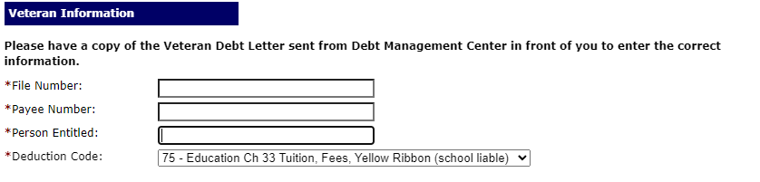
How to Pay a Debt on www.pay.va.gov
Payee and Person entitled name format are on DMC school debt letters
Use RID for Education Debts
Payee is not always 00, please verify payee on DMC letter
Deduction Code is not always 75, please verify on DMC letter

Slide 21
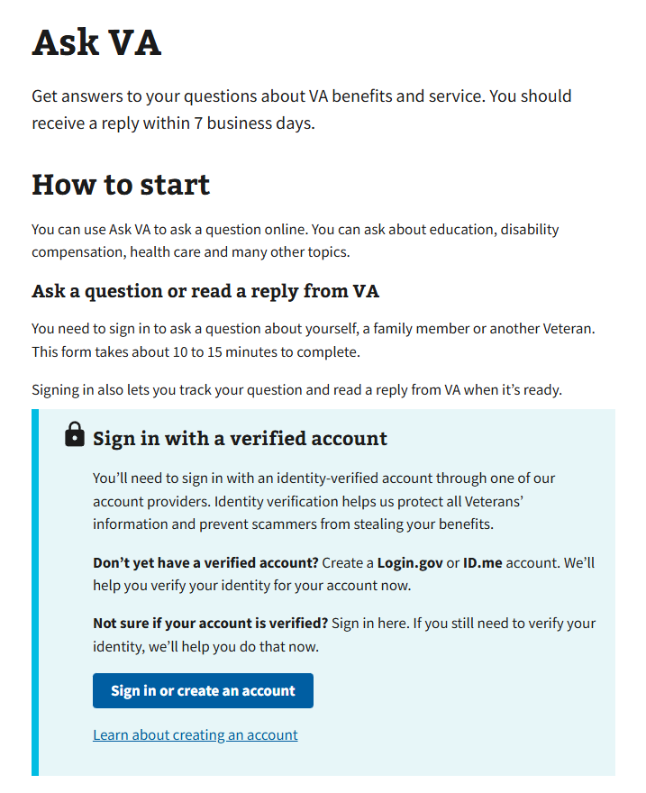
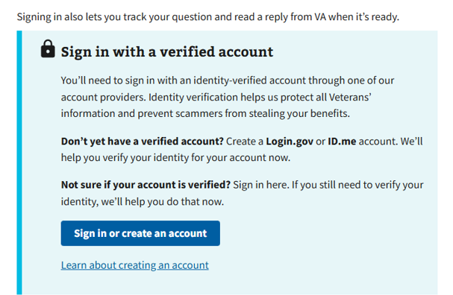
Ask VA (AVA)- for School Inquiries
All school inquiries and disputes should be submitted using AVA https://www.va.gov/contact-us/ask-va/introduction

Slide 22
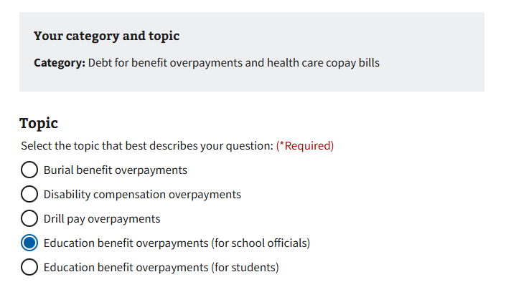
Ask VA (AVA) for School Inquiries
Choose “Debt for benefit overpayments and health care copay bills” as the category and “Education benefit overpayments (for schools)” as the topic

Slide 23
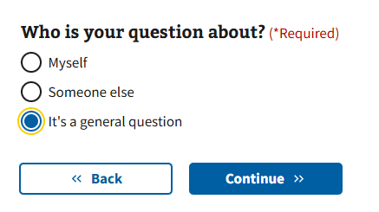
Requesting a debt list in AVA
DMC can provide debt lists by facility code upon request
Since the debt list is not associated with one specific Veteran, you can choose It’s a general question on the “Who is your question about screen” to submit your debt list by facility code request
If you have multiple facilities, list the additional facility codes in the “What is your Question?” box

Slide 24
DMC School Official Debt Line
833-720-2574 (international 612-843-6508)
Use for questions on Post 9/11 GI Bill Tuition and Fees debts such as:
      Term dates for a debt
      Confirm a payment was received
      Confirm an outstanding balance
      Assistance with an online payment
Disputes must be in writing. Submit via https://www.va.gov/contact-us/ask-va/ (Select category: “Debt for benefit overpayments and health care copay bills” and topic: “Education benefit overpayments (for schools)”

Slide 25
Student Options
Student Options
Pay in Full
Dispute
Payment Plan
Waiver
Reduced Benefit Offset
Compromise
Temporary Suspension
Notes:
Payment Plan: If the student is not receiving benefits and is unable to pay the debt in full, DMC can consider requests to make monthly payments
Compromise: A compromise means DMC accepts a lesser amount of money as full settlement of a debt. DMC considers compromise offers when the debtor is unable to pay the debt in full or pay the debt in a reasonable timeframe through monthly payments.
Waiver: A waiver request is a request for forgiveness of the debt. If a waiver is granted, the student will not be required to pay the amount that was waived; however, their entitlement will be charged for the amount waived. A waiver must be requested within 180 days of DMC’s first notification letter to the student. Waiver requests are considered by a special committee known as the Committee on Waivers and Compromises.
Temporary Suspension: DMC can provide temporary suspensions for disaster relief in FEMA declared disaster areas, and we can also work with students on a case by case basis if they are temporarily unable to make payments due to financial hardship. Suspensions do not extend the student’s timeline to request a waiver.
Dispute: The student has the right to dispute the existence or amount of their debt. DMC forwards disputes to the RPO of jurisdiction for review.

Slide 26
VA Debt Portal for Veterans
Debt Portal: https://www.va.gov/manage-va-debt/
      Veterans can log in to view balances
      FAQ’s
      Email notifications to Veterans
      Online VA Form 5655 Financial Status Report (FSR)
      Online Dispute
      One VA Digital Debt Letter

Slide 27
Treasury Overview Debt Collection Tools
Treasury has two main programs for student and school debt collection
Treasury Offset Program (TOP)
Cross-Servicing (CS)
Federal grants
Social Security
Civilian pay
Military retirement
Private Collections Agencies (PCA)
Telephone collections
Administrative Wage Garnishment (AWG)

Slide 28

Become a Debt Superstar (Contact DMC)
https://www.va.gov/contact-us/ask-va/ | Online inquiry system (category: Debt for benefit overpayments and health care copay bills, topic: Education benefit overpayments (for school officials)
https://www.va.gov/manage-va-debt/ | Veteran Debt Portal
833-720-2574 | DMC School Official Debt Line
800-827-0648 | DMC Toll Free Line - Students

Slide 29

Issue Not Getting Resolved
Julie Lawrence – Chief of Operations, Veterans Resolution Division
Julie.Lawrence@va.gov
Nicole Haselberger – Assistant Chief, Veterans Resolution Division
Nicole.Haselberger@va.gov
Tami Dorle – Supervisory Financial Administrative Specialist , Veterans Resolution Division
Tamara.Dorle@va.gov

Slide 30
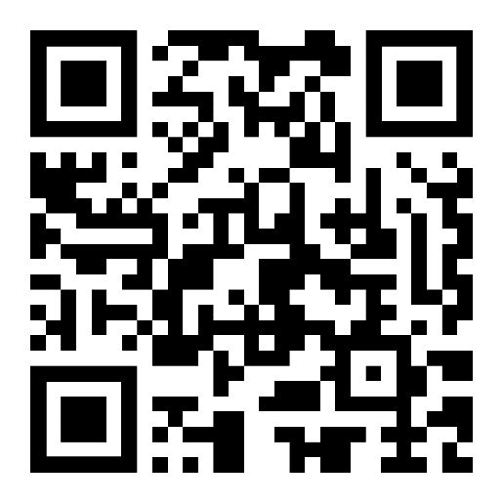
DMC Presentation Survey
DMC values your time and feedback on our presentation. We would appreciate it if you’re able to complete the survey below.
  https://www.surveymonkey.com/r/DMCSCO

Slide 31
Backup

Slide 32
Deduction Codes for School Debts
Found on the top right of DMC letter
  Can be any of the following:
  75, 63, 91, 92, 93, 94, 95, 96, 97, 98
  Please also remember to verify the payee for online payments (not always 00)

Slide 33
Example of Congruent Offset
Congruent Payment Recoupment Example
SCO certifies term 09/01/2024 – 12/15/2024,12 in-residence credits, T&F $10,000.00
VA pays $10,000.00 for the 09/01/2024 – 12/15/2024 term
Student drops prior to the start of the term creating debt of $10,000.00
Same student is certified for the mini-term of 10/01/2024 – 11/15/2024 for 6 in-residence credits with a tuition and fees of $5,000.00.
VA will not release any T&F payment and will reduce the outstanding T&F debt by $5,000.00
If facility has already submitted a repayment of $10,000.00 to the Debt Management Center (DMC), VA will send $5,000.00 to the facility

Slide 34
Debt Establishment: Compliance Survey
Debt | Collection | Source | Dispute
School Debt | DMC collects | Tuition/Fees/Yellow Ribbon | Dispute with DMC
Student Debt | DMC collects | Books/Supplies Housing/Kicker | Dispute with DMC
Potential School Liability | RPO collects (no DMC involvement) | School may have to repay Books/Supplies/ Housing/Kicker on behalf of students | Special process (no DMC involvement)

Slide 35
Tips for School Inquiries
When submitting disputes and inquiries via AVA, please include:
One inquiry per student
Identifying information for the student
School name and facility code
Debt amount
Supporting details (front and back of cashed check, when was updated certification sent, etc.)

Slide 36
How to Contact TOP
Schools may contact TOP by calling the TOP Call Center:
1-800-304-3107
To provide you with information about an offset, Treasury will need to know:
The caller’s name, department and job title. The job title will need to indicate a need-to-know position
At least one of the following:
  date of the payment
  amount of the original payment
  amount of the offset
Make sure to obtain the Debt Account ID related to the offset from Treasury (typically ends in 0075 for school tuition) before contacting DMC about an offset

Slide 37
When to Contact TOP vs. DMC
Information Treasury Has
Debt Account ID number for a given offset (can look up debt account ID with offset info)
Entity that referred a debt that was offset
Information about payment that was offset
Information DMC Has
Details about debt we referred (need Debt account ID from Treasury to identify debt)
  Student associated with referred debt
  Term dates for referred debt

Slide 38
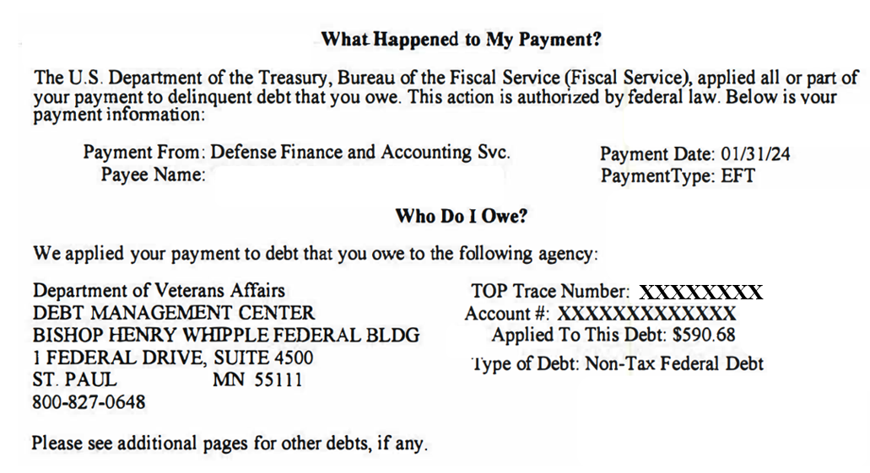
TOP Letter Example

Slide 39
Federal Debt Collection Laws
The Debt Collection Act of 1982
  Authority for collection by administrative offset
The Debt Collection Improvement Act (DCIA) of 1996
  Agencies required to refer delinquent non-tax debts to the Department of Treasury at 180 days
Digital Accountability and Transparency Act (DATA) of 2014
  Changed referral requirement for delinquent non-tax debts from 180 days to 120 days

