Slide 1



NORTH CAROLINA TUITION ASSISTANCE PROGRAM (NCTAP)
Education Services Office
(984) 664-6272
Hours of Operation
0830-1600

Slide 2



01.
RESPONSIBILITIES OF STUDENT VS. VENDOR
02.
BECOMING A VENDOR
03.
CERTIFICATION FORMS
04.
BENEFITS
TABLE OF
CONTENT

Slide 3
HELLO
Welcome to NCTAP! Your future starts here!
Imagine this: You’re standing at the door of an incredible opportunity—one that could shape your career, give you hands on experience, and set you up for success. But before you step through that door… you need to prove you’re ready.
Learn everything you need to know about NCTAP and what it takes to be successful. Pay attention, because at the end there’s a quiz—only the best prepared will pass!

Slide 4



INTRODUCTION
The North Carolina Tuition Assistance Program was established under the North Carolina National Guard Tuition Assistance Act of 1975. We aim to encourage voluntary membership in the NCNG, enhance the educational level of its members, and benefit the state as a whole.

Slide 5
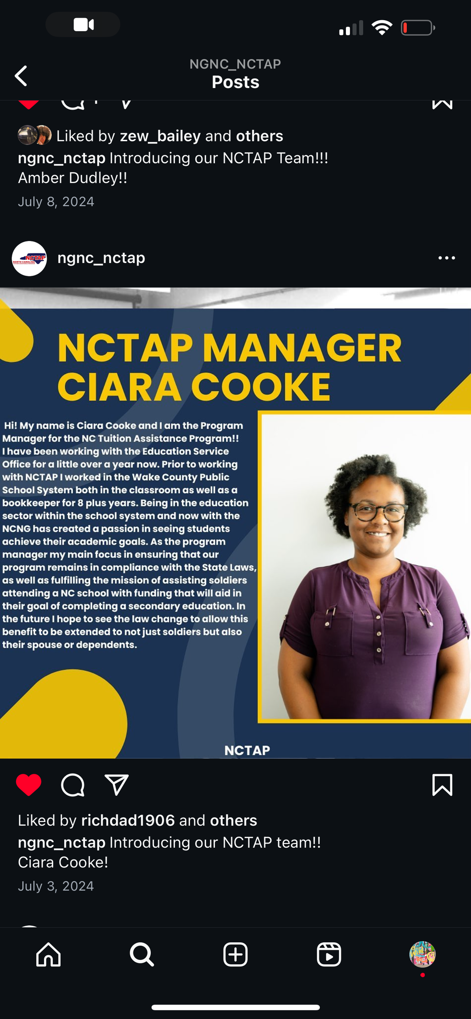
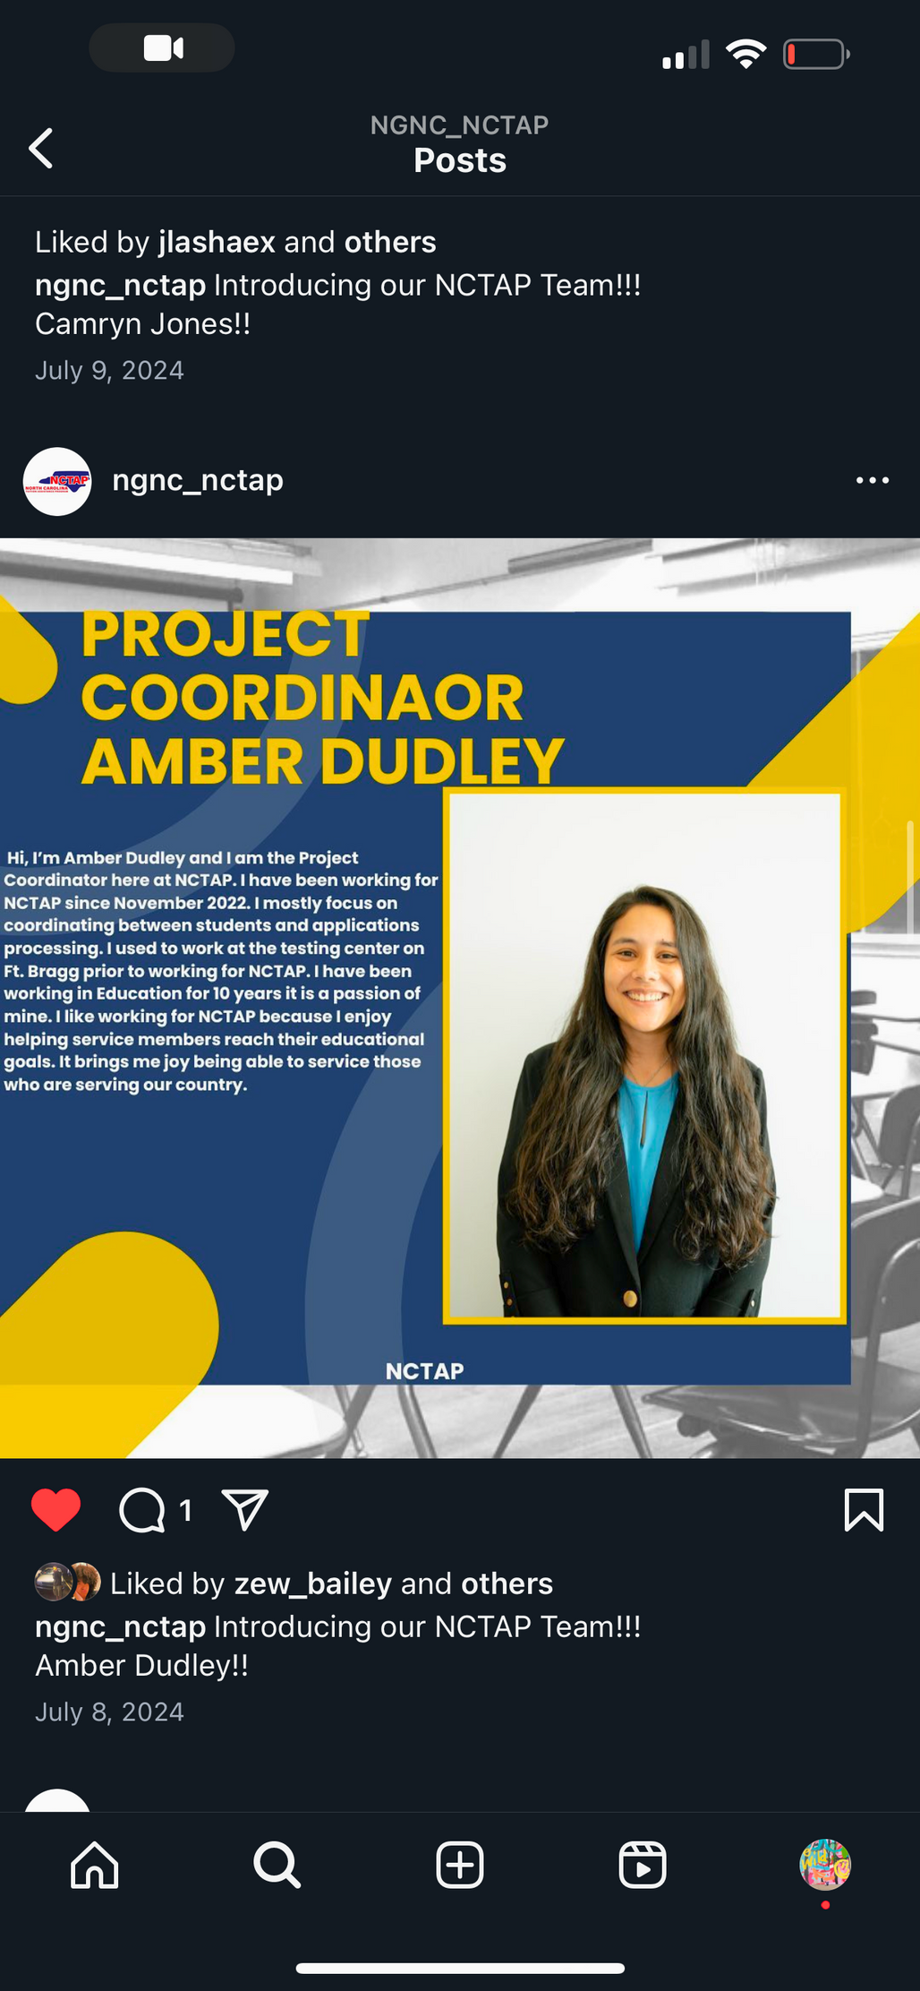

Ciara Cooke - Program Manager
Ensures the program remains in compliance with State Laws, as well as fulfilling the mission of assisting soldiers with funding that will aid in their goal of education.
Amber Dudley - Project Coordinator
Supports students in the application process with a focus on helping navigate requirements and deadlines. Dedicated to making the journey to enrollment as seamless as possible.
MEET OUR TEAM
Tessa Thompson - Project Coordinator
Serves as primary contact for schools, assisting with certs and ensuring a smooth process. Focuses on clear communication and support while helping schools navigate requirements efficiently and effectively.

Slide 6
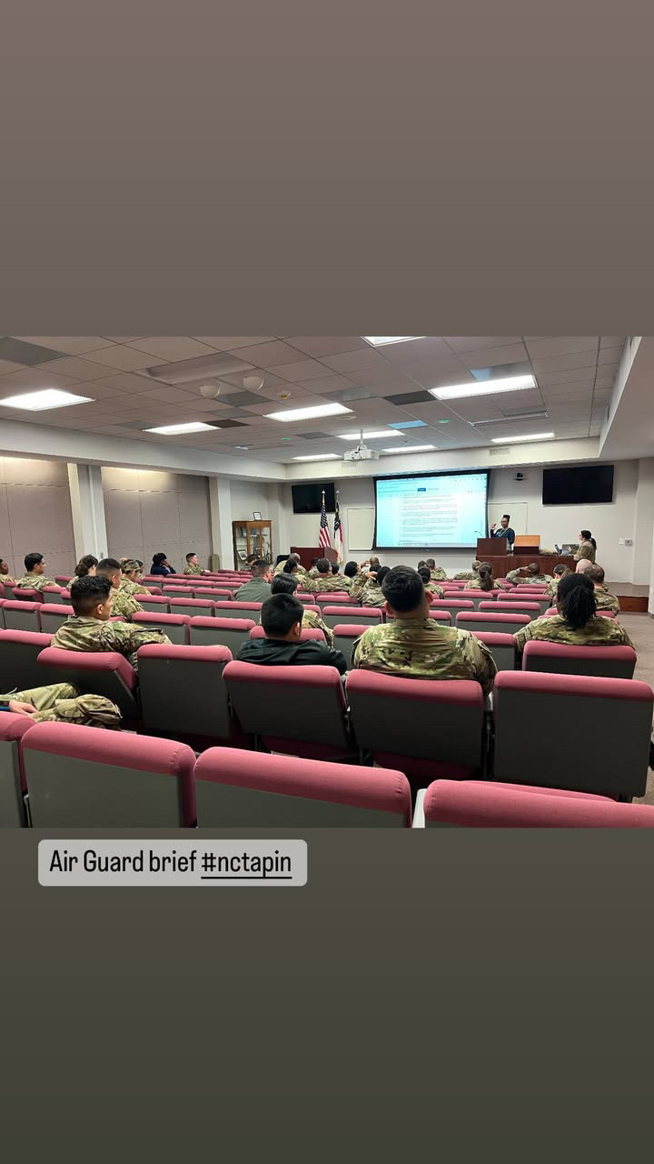
WHAT IS NCTAP?
  NCTAP is a reimbursement benefit provided by the State of North Carolina in support of the North Carolina National Guard.
  We assist with tuition cost for all NC based Community Colleges, Public and Private Colleges, Universities and some trade schools up to the established cap (subject to change based on state budget).
  NCTAP covers 100% tuition and fees for all NC Community Colleges and promise schools ONLY.
Notes:
Promise Schools are FSU, Elizabeth City State, UNCP, and Western Carolina

Slide 7

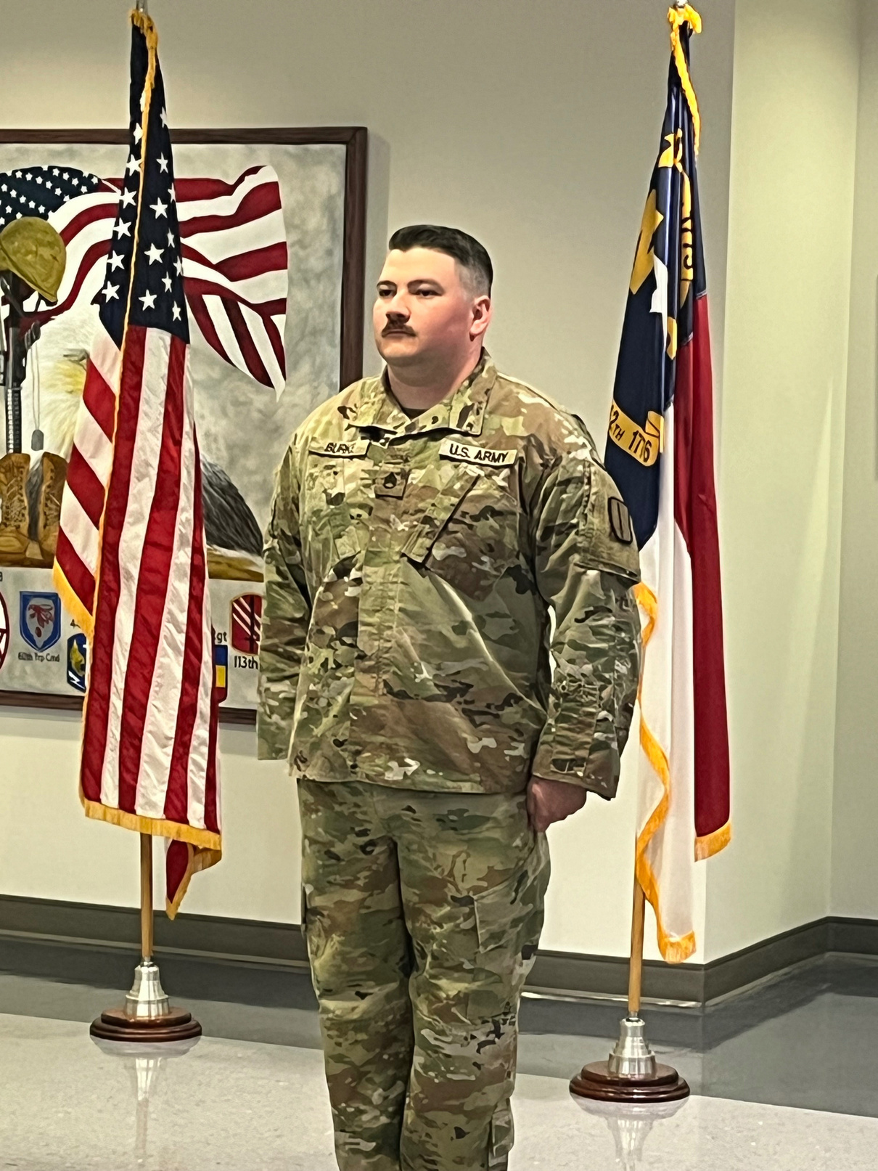
REQUIREMENTS?
  Enrolled in NC based school.
  Must be actively drilling with no flags at current unit.
  2 year service obligation set by the state based on the end of term in which the benefit is awarded.
  Submit a completed application packet for each semester you are requesting funds. Packet includes:
  Class schedule issued by the school
  Itemized tuition bill showing breakdown in tuition and fees
  Final grades for returning applicants only (must maintain a 2.0 GPA at the end of each term)
Notes:
Talk about tuition bill needing to be instate tuition and not out of state.
Put residency website here for anyone who needs it

Slide 8
WHAT DOES NCTAP COVER?
100% Tuition and Fees
All NC Community Colleges
4 Promise schools
Elizabeth City State University
Fayetteville State University
University of North Carolina at Pembroke
Western Carolina University
Only 100% Tuition for for every other Public, Private, Flight, and MISC. school (not to exceed cap limit)
  If student is receiving FTA at 100% then they are eligible for fees only.
  If student is receiving CH33 or FTA and tuition is not 100% covered, then NCTAP will cover the remaining tuition plus the additional amount for fees.
  The cap limit of NCTAP is $3240 (Undergraduate/Flight Schools) and $3360 (Graduate)
** Fees will be determined based on application number and budget

Slide 9
01.
RESPONSIBILITIES OF STUDENT VS. VENDOR

Slide 10


VENDOR
Verify correct number of credit hours enrolled in, making SAP, default of any student loans, and CH33 benefits (post 9/11).
** If student drops course after funds are disbursed, funds must be returned per state legislation. NCTAP manager must be notified.
STUDENT
  Must apply for NCTAP on their own
  Must notate correct amount of credit hours currently enrolled
  If student drops course before payment, they must notify our office
Notes:
Talk about process of returning funds to the State?
Letting VA rep know they wanna apply for NCTAP is not actually applying. The student must go to website to actually apply.

Slide 11
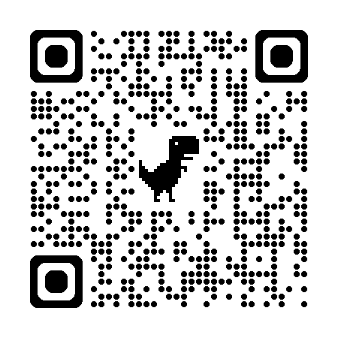
How do students apply?
Application Period
The application process has 2 parts!
First go to our website and complete the online application form.
Then respond to our automated email with the required supporting documents.
**Failure to submit all required docs by the deadline will result in a denial. NO EXCEPTIONS
Spring: 1 January - 30 January
Fall: 1 August - 31 August
Summer: 12 April - 10 May
Notes:
Deadline meaning end date by close of business which is 5pm.
Please do not submit more than 1 application. If you made a mistake or need to make updates, email us to make changes.
10 day notice emails are automatic and no action is needed if all supporting docs have already been submitted.

Slide 12
02.
BECOMING A VENDOR

Slide 13



W-9 Form
https://www.osc.nc.gov/state-north-carolina-sub-w-9/open
** Be sure to fill out form in its entirety. The NC office of state controller will reject the form if not completed, and this will delay getting an account set up with the state.
EFT Form
TAX INFO
https://www.osc.nc.gov./vendor-electronic-pay,ent-form-instructions/open
The info must match on both forms regarding: Name / DBA / SSN or tax ID number / W-9 designation (problem spot)
First time schools MUST complete 2 forms to become a vendor with NCTAP.
Notes:
All EFT forms must be sent to Office of State Controller not to us at NCTAP

Slide 14

Point of contact (POC)
  A POC is appointed at each institution to process certification forms and award amounts for the students who apply. Certs are done via email and must be turned in NLT 5 business days upon receipt.
  The POC should have access or be able to verify student info regarding SAP, default of student loans and CH33 benefits (post 9/11).
  If a POC retires, quits, or changes jobs, a new designee must be appointed. Please notify NCTAP as soon as possible.

Slide 15

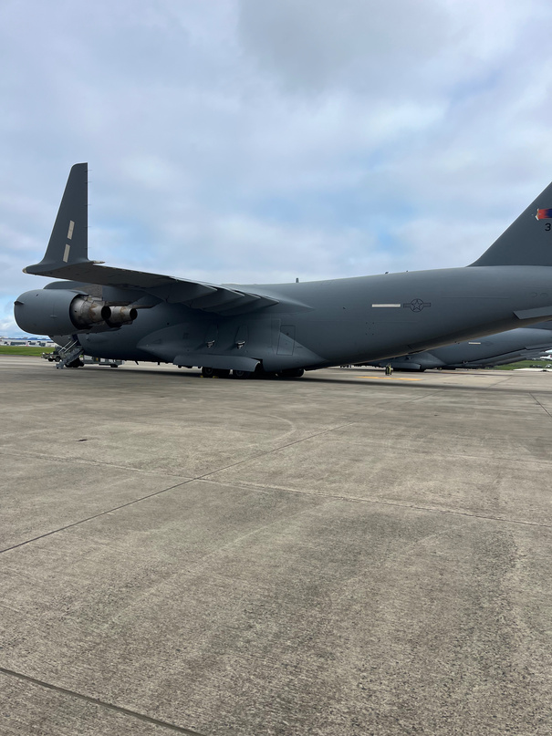
F
P
FLIGHT SCHOOLS
PROMISE SCHOOLS
  Executive Flight School
  Raleigh Pro Flight
  Dillon Aviation
  Hightide Aviation
  Elon Aviation
  Pressley
  Flightgest
  Total Flight solutions
  Blueline Aviation
  Embry Riddle
  Fayetteville State University
  Elizabeth City State University
  University of North Carolina at Pembroke
  Western Carolina University
  ECPI
  South College
  911 E-Learning
  Carolina College of Bublical Studies
  Carolina College of Health Studies
  Watts College of Nursing
All NC Universities and Community Colleges. Additionally some out of state Universities with physical campuses in the State.
MISCELLANEOUS
NC UNIVERSITIES
M
NC
Notes:
Remember only promise schools and community colleges are covered at 100%. All other schools are tuition only up to our cap.
Undergrad 3240
Graduate 3360
Fees will change based on state budget

Slide 16

“JUST KEEP MOVING FORWARD.”

Slide 17
03.
CERTIFICATION FORMS

Slide 18
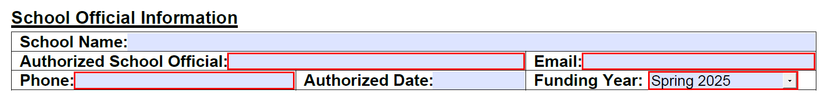
FILLING OUT CERTIFICATION FORMS
POC INFO
The school official information should be the correct name, phone number, and email for the POC filling out the form. If the POC changes or needs updates, please include a note of this on the changes page (page 3).

Slide 19
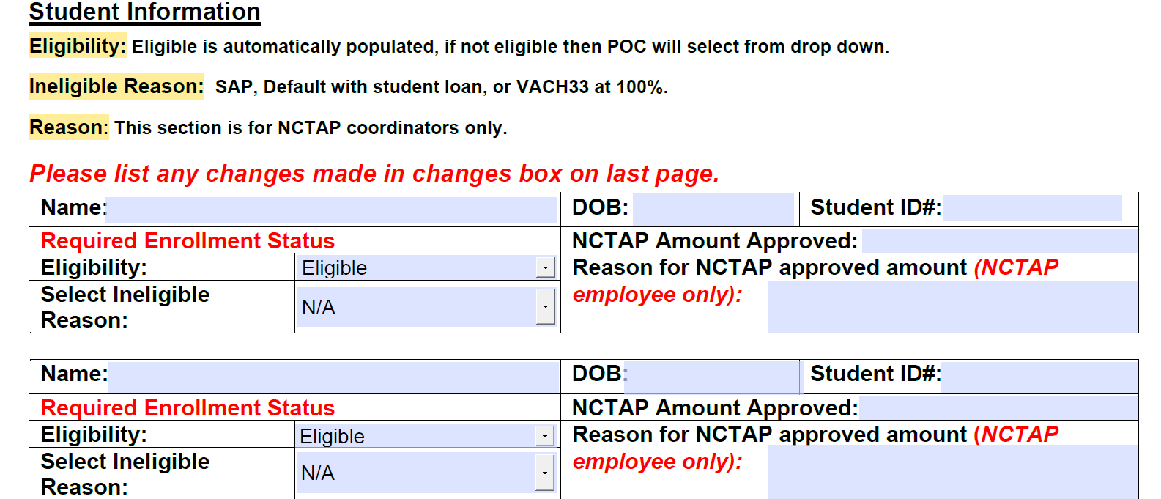
FILLING OUT CERTIFICATION FORMS
STUDENT INFO
STEP 1
Look up student name to verify SAP and enrollment.
STEP 2
Fill in student ID
STEP 4
STEP 3
If student is ineligible change here and select ineligible reason. For students already marked ineligible, they do not meet NCTAP requirements and no further action is needed.
Verify correct tuition amount. if incorrect please change it and note changes in changes box on page 3.

Slide 20

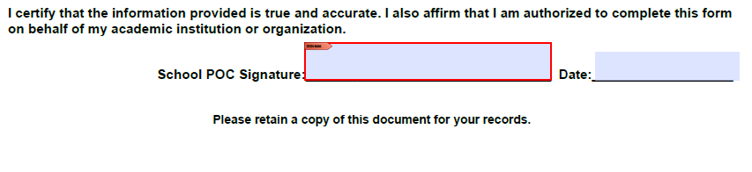
FILLING OUT CERTIFICATION FORMS
CONTINUED
STEP 5
Indicate any changes made in this box which is located on page 3 of the form.
STEP 6
POC is required to sign and date at the bottom of page 2 before returning to NCTAP.
Notes:
Note please sign 2nd page where it says school POC. All signatures on the last page are for NCTAP only

Slide 21
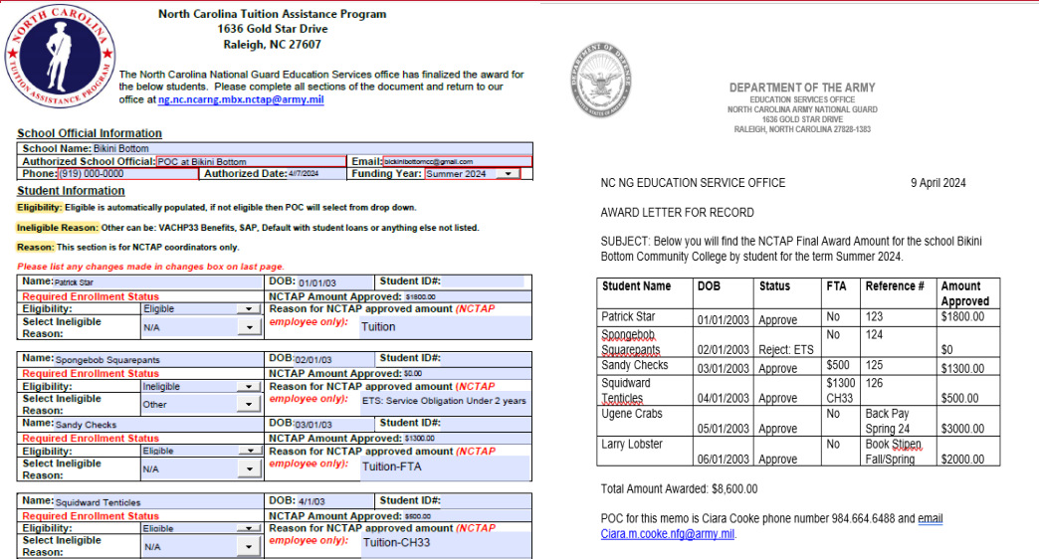
EXAMPLE CERT AND AWARD LETTER
Notes:
When are award letters sent

Slide 22
  Funding is disbursed by the North Carolina Department of Public Safety.
  NCTAP is a reimbursement program and NOT designed to meet deadlines set by the school.
  Funds are typically disbursed no later than end of term and reach the school 1-2 weeks after disbursement date but can take longer.
TIMELINE
During this time NCTAP will check student ETS dates and FTA funds to ensure eligibility.
APPLY FOR BENEFITS
CERTIFICATIONS
Apply for the current semester during our open application period. Also, send in supporting documentation before the deadline in order to be approved.
NCTAP will coordinate with schools to verify student information and enrollment. This process should be complete within 5-7 business days.
REQUIREMENT CHECKS
DISBURSMENTS
Notes:
Talk about recoupments and maybe certain cases where someone will commission out

Slide 23
04.
BENEFITS

Slide 24
OTHER BENEFITS
CH33/CH1606
CA
FTA
  VA CH33 is the Post 911 GI Bill.
  If student receives CH33 at 100% rating they will NOT be eligible for NCTAP.
  If student receives CH33 at a lower rating, NCTAP will pay the remaining cost of tuition up to our cap plus fees (VA will pay first).
  Students may combine CH1606 with NCTAP
  CA is Credential Assistance
  Students may use CA and NCTAP combined if perusing a certification in addition to a degree
  FTA is Federal Tuition Assistance
  If student receives FTA and it covers the full tuition, they will NOT be eligible for NCTAP.
  If student receives FTA and it does cover the full tuition, NCTAP will cover the remaining cost of tuition up to our cap plus fees (FTA will pay first).

Slide 25


QUESTION 1
What is NCTAP?

Slide 26
What documents do vendors need to submit with the State to become a vendor?
QUESTION 2

Slide 27
NCTAP covers 100% tuition and fees for every school in the State.
QUESTION 3
True or False

Slide 28
Can you combine NCTAP with other benefits?
QUESTION 4

Slide 29
School POCs have until the end of term to return student verification forms.
QUESTION 5
True or False
Notes:
False we request the forms to be returned no later than 5 business days

Slide 30

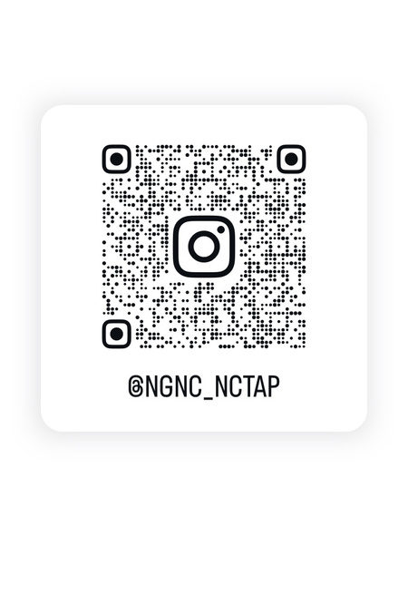
THANK YOU
Do you have any questions?
Phone: (984) 664-6272
Email: ng.nc.ncarng.mbx.nctap@army.mil
Website: North Carolina Tuition Assistance Program (NCTAP) NCNG
Notes:
Please follow our instagram for updates

