Slide 1
UNC System Update
NCACVA Spring Conference
March 2025

Slide 2


The University of North Carolina System
The UNC System is the governing and policy-making body for all public universities in the state of North Carolina.
Currently, there are apx. 22,000 military-connected students attending UNC System Schools.
Fall 2024 Military-Affiliated Student Enrollment – 22,462
(Up from 21,773 in fall 2023)
Post-911 and DoD Tuition Assistance - $53.7M for AY23-24
(Up from 52.6M in fall 2023)

Slide 3
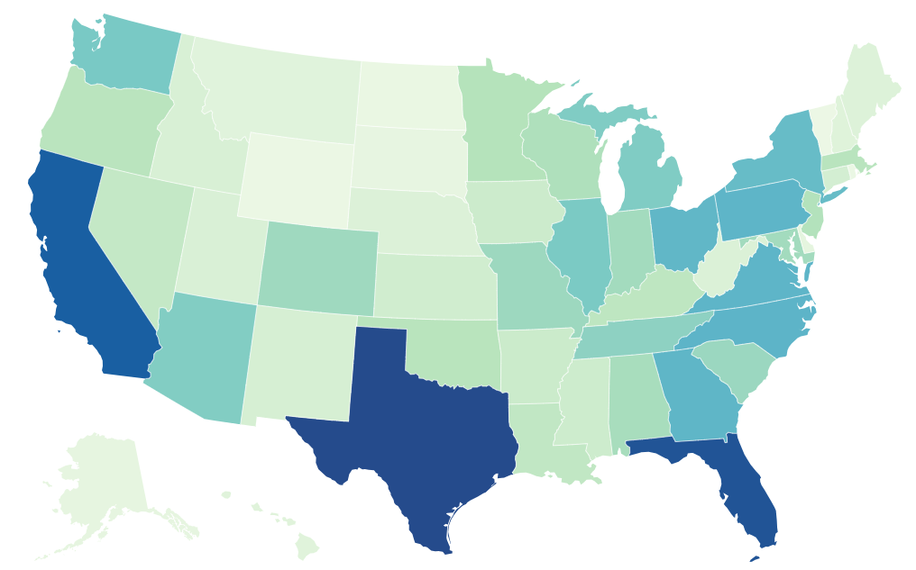
Active Duty and Veterans in North Carolina
North Carolina Ranks 4th in the nation for both number of active-duty service members and veterans.
Currently, there are apx. 138,084 active-duty personnel and 615,440 Veterans living in NC.
Active-duty is data based on June 2024 military personnel report by The Defense Manpower Data Center.
Veteran data is based on data from the US Census Bureau’s 2023 American Community Survey

Slide 4
Our Strategic Commitment to NC Military: Military Enrollment
Strategic Plan
Baseline: 20,455 (Fall 2021)
Target: 25,000 by 2027
Current: 22,242 (Fall 2024)
Closing the gap:
16% growth
over five years
(v. 3% overall enrollment growth)

Slide 5
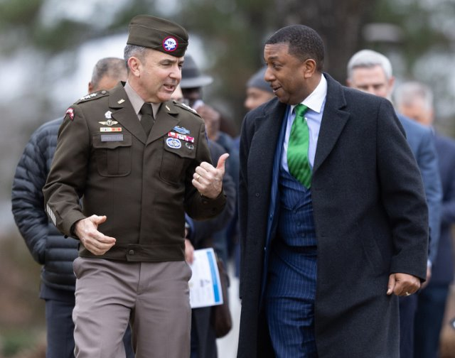
System Initiatives: Serving Military Affiliated Students
Making our system more military friendly
Strategic partnerships between campuses and NC military installations
Policies that encourage applicants to choose our schools
Chancellor Darrell Allison and Lieutenant General Gregory Anderson at the signing of FSU’s official Education Partnership with the XVII Airborne Corps
Notes:
Update the update with project status, total numbers

Slide 6
System Initiatives: Military Student Success Regulation
UNC System Regulation Signed 11/23/22
Codifies key terms “Military Student” and “Military–Affiliated Student”
    Ensures equity among Military and Military-Affiliated Students by updating policies around application fees and priority registration
Per UNC System Regulation 700.7.1:
The term “military student” shall mean any student who is a veteran or actively serving member of the United States Uniformed Services as defined in 37 U.S.C.§101(3), a member of the military reserves, or a member of the National Guard.
The term “military-affiliated student” shall include both “military student” as defined above and any student who is the spouse, child, surviving spouse, or surviving child of a “military student” as defined above, as well as any student who is a Reserve Officers' Training Corps (ROTC) cadet.

Slide 7
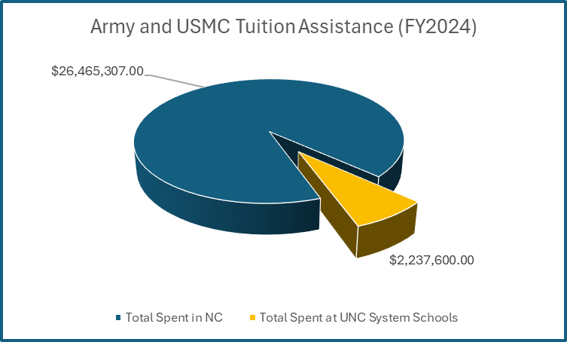
System Initiatives: Military Tuition Assistance
Request to NC General Assembly to grant flexibility for UNC institutions to discount tuition for service members using military TA.
91.5%
Percentage of Tuition Assistance spent by the Army and Marine Corps on service members living in our state that does NOT come to the UNC System
HB 373
UNC Tuition Discounts for Certain Students
filed March 11, 2025
Notes:
Theme = Serving Our NC Military Family (State Initiatives)

Slide 8




System Initiatives: Serving Military Affiliated Students
Ensuring consistent support and resources
Hosting monthly meetings with staff who work with military-affiliated students.
Educating staff about the specific needs of military-affiliated students
Mental health and suicide prevention training
Notes:
Theme = Serving Our NC Military Family (Inst. Initiatives)

Slide 9
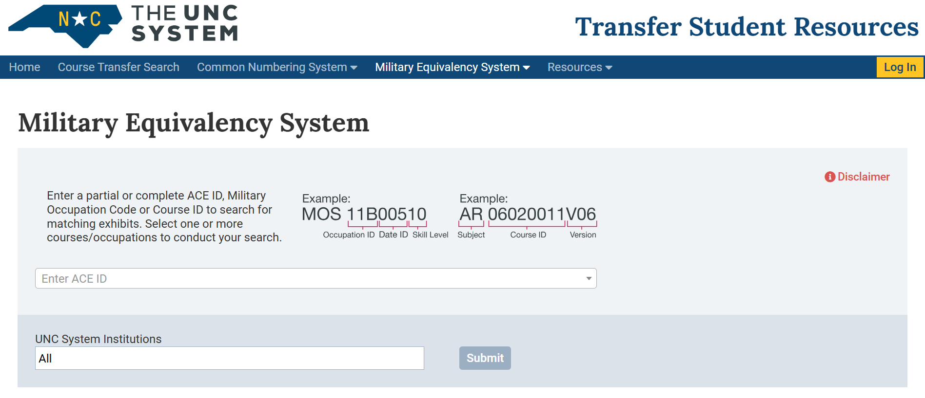
System Initiatives: UNC Military Equivalency System (MES)

Slide 10
Military Equivalency System (MES): How It Works
The American Council for Education (ACE) enlists faculty from across the country to review learning outcomes of military training courses and occupational experience and offer recommendations for course credit.
Recommendations are attached to a code called the ACE ID.
Each ACE ID is aligned by UNC institutions (faculty) with equivalent courses at the institution.
Registrars enter matches as an “equivalency rule” in their SIS (Banner or PeopleSoft) to be awarded for future students.
Equivalencies in MES include historical military credit awarded and UNC faculty panel recommendations.
Notes:
Removed from the slide but mention Dr. Michelle Soler and Dr. Rondall Rice by name here. (note Rondall has a PhD)

Slide 11
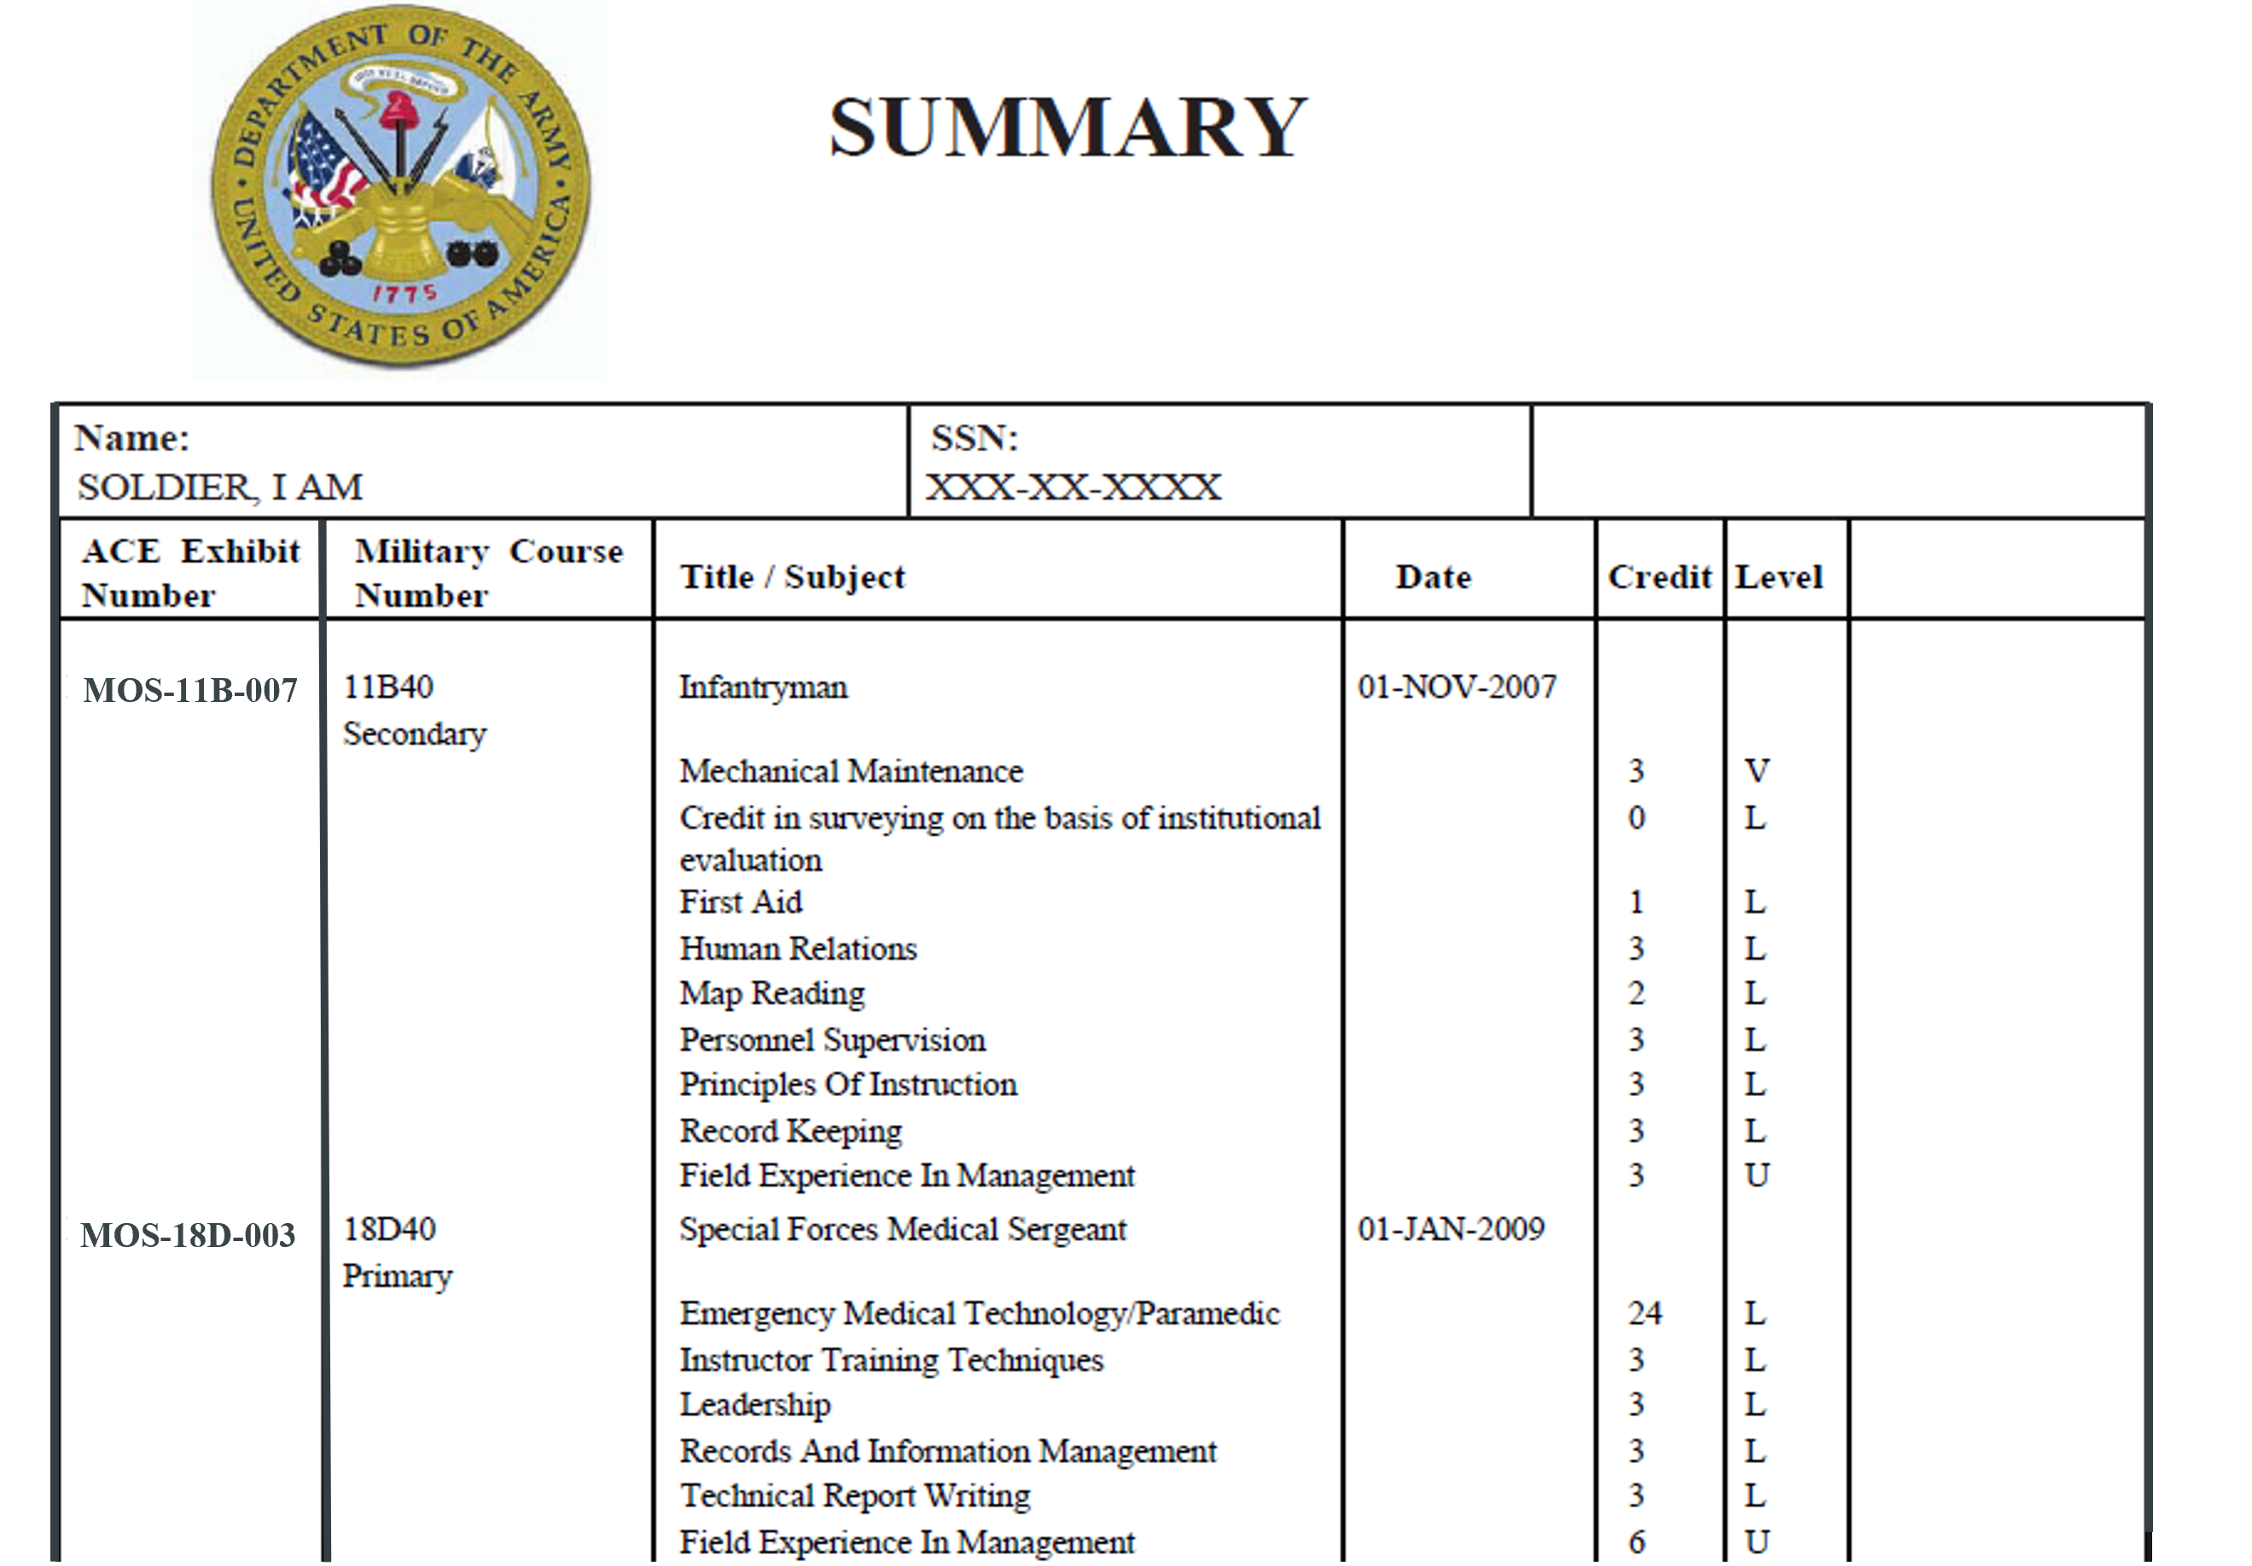
Joint Service Transcript (JST) Example
Notes:
Update on the ACE partnership

Slide 12
UNC Military Equivalency System (MES) Milestones
May
2022
Military credit policy
regulation signed
by President Hans
August
2022
MES project start
March
2024
Phase II complete:
Public portal launched
5,000 equivalencies
June
2023
Phase I complete:
Internal infrastructure
Spring 2024-Now
Worked with UNC institutions to enter equivalencies
January
2025
ACE data exchange pilot complete
April
2025
17,000 equivalencies
Workforce aligned nursing equivalencies captured
Notes:
Theme = Serving Our NC Military Family (System Initiatives)
Where have we been and where are we now?
Progress since the committee was briefed in May 2024
-9,000 equivalencies (May 2024) to >17,000 equivalencies (March 2025)
-Workforce aligned equivalencies for Nursing added to MES
-Recognize and thank institutions for their hard work, diligence, collaboration

Slide 13

UNC Military Equivalency System (MES): Next Steps
Build out MES Database
    -Finalize entry of first faculty panel data (Nursing)
    -Convene additional faculty panel
        -Historical data “cleanup”
        Finalize administrative interface
          -Used to manage ongoing operations
Optimize user experience on public-facing component
  -Document upload capability
  -“How to” video
  -Ticketing system for users to request approval/denial of equivalencies
Notes:
Theme = Serving Our NC Military Family (System Initiatives)
Where are we going next?
-User experience
-Expanding # of equivalencies in the system (existing + more faculty panels)
-Enhancing features for UNC System users such as Admin Portal

Slide 14
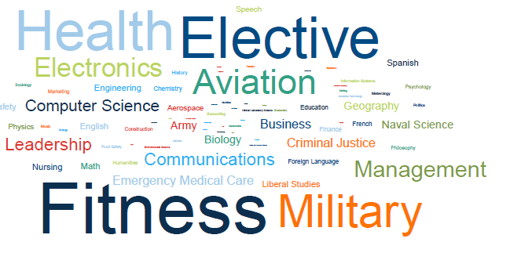
UNC Military Equivalency System (MES): Next Steps
Signed agreement with American Council on Education (ACE) to participate in a pilot data-sharing project. Project will be completed as of 2/28/24.
ACE data will help the UNC System increase data consistency for search and display and reduce burden on personnel.
Access to this data will enable the UNC System to be on the leading edge of updates to JSTs, which are complex and continually evolve.
Credit Award Subjects
The UNC System is creating a multi-year dataset of military credit awarded to share with ACE. This will inform DoD decisions on military education programs and benefits in the future.
Notes:
Theme = Serving Our NC Military Family (System Initiatives)
Where are we going next?
-User experience
-Expanding # of equivalencies in the system (existing + more faculty panels)
-Enhancing features for UNC System users such as Admin Portal

Slide 15
Military Equivalency System (MES): Building the Database
Faculty Panels
Help institutions determine new equivalencies via faculty panels
Convened first panel of UNC System nursing faculty in fall 2024
Nursing selected based on high NC workforce demand and projected separations of service members with matching skills/occupations
Notes:
Update the update with project status, total numbers

Slide 16
Military Equivalency System (MES): Building the Database
Rank | MOS | MOS Title | Count
1 | 11B | Infantryman | 3,971
2 | 311 | Rifleman | 2,145
3 | HM | Hospital Corpsman | 1,765
4 | 3531 | Motor Vehicle Operator | 1,688
5 | 91B | Wheeled Vehicle Repairer | 1,402
6 | 68W | Health Care Specialist | 1,275
7 | 111 | Administrative Specialist | 1,065
8 | 621 | Field Radio Operator | 1,036
9 | 92Y | Unit Supply Specialist | 984
10 | 3521 | Automotive Maintenance Technician | 891
11 | 37F | Psychological Operations Specialist | 889
12 | 42A | Human Resources Specialist | 749
13 | 25U | Signal Support Systems Specialist | 737
14 | 25H | OTHER - UNKNOWN | 695
15 | 25B | Information Technology Specialist | 677
16 | 3043 | Supply Administration and Operations Specialist | 654
17 | 88M | Motor Transport Operator | 608
18 | 92A | Automated Logistical Specialist | 606
19 | 300 | Basic Infantryman | 604
20 | 31B | Military Police | 602
21 | 372 | Critical Skills Operator | 602
Additional Faculty Panels:
Priority areas will be tied to highest NC workforce needs and skills/ occupations of transitioning NC servicemembers.
Our plan is to focus on one academic area per semester.
Top Military Occupations for NC Active-Duty Personnel with Projected End Years 2024-2028. Data from NC Department of Commerce / Defense Manpower Data Center (DMDC)
Notes:
Update the update with project status, total numbers

Slide 17
Military Equivalency System (MES): Building the Database
Analyzing new JSTs:
During spring 2025, our team is developing a ticketing system for JST analysis that students and campus staff can use.
In the meantime, students are advised to work directly with their campuses to have their JSTs evaluated.
Students and staff can also reach our team at military@northcarolina.edu.
Notes:
Update the update with project status, total numbers

Slide 18
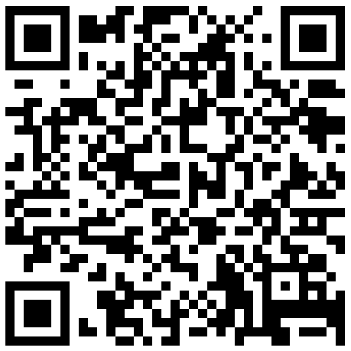






Military Equivalency System (MES): “Getting the Word Out”
2024 Efforts:
Collaboration with UNCSO Communications team to ensure widespread marketing of MES.
Notes:
Update the update with project status, total numbers

Slide 19
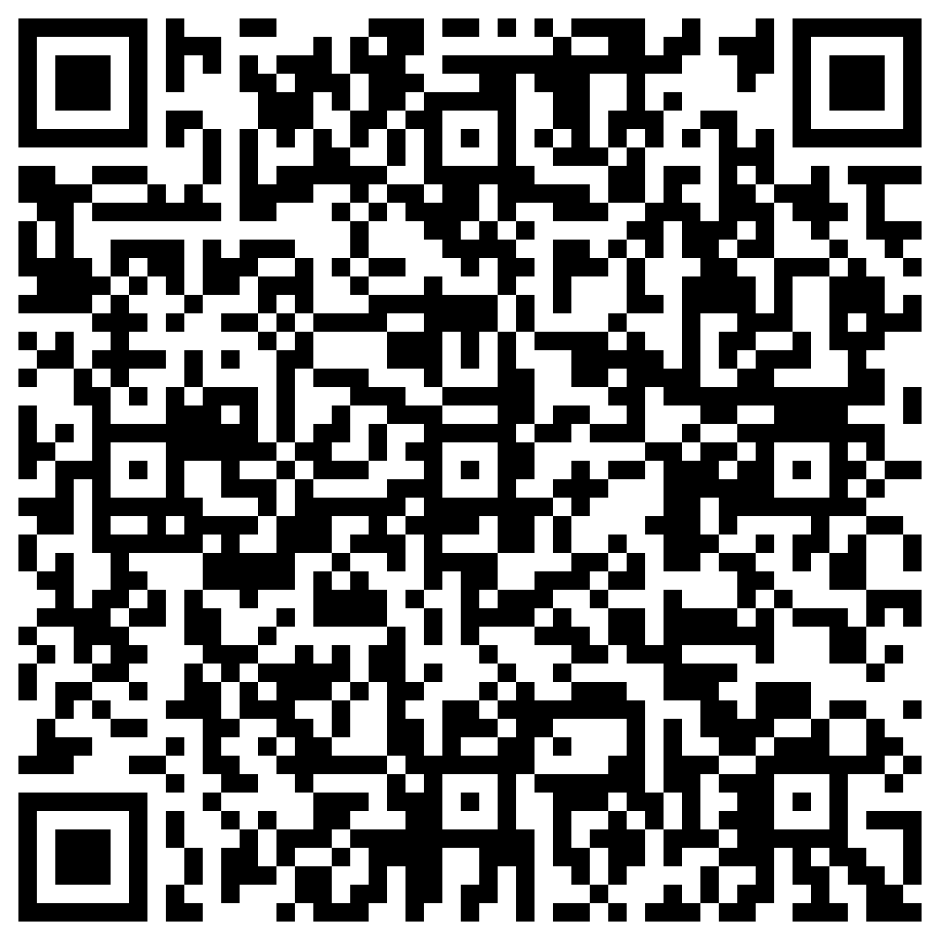
UNC System Office: Questions?
Bradley Wrenn
Program Manager for Military and Veterans Education
UNC System Office
www.northcarolina.edu/military
btwrenn@northcarolina.edu
Brad’s Contact Info
Notes:
Update the update with project status, total numbers

