Slide 1
Compliance and Tuition Assistance
Dr. Brandyy Wade
Central Piedmont Community College

Slide 2
Introduction
SCO Handbook
Risk-Based Survey
Catalog Approval
DOD Compliance for TA
Tuition Assistance
Questions

Slide 3
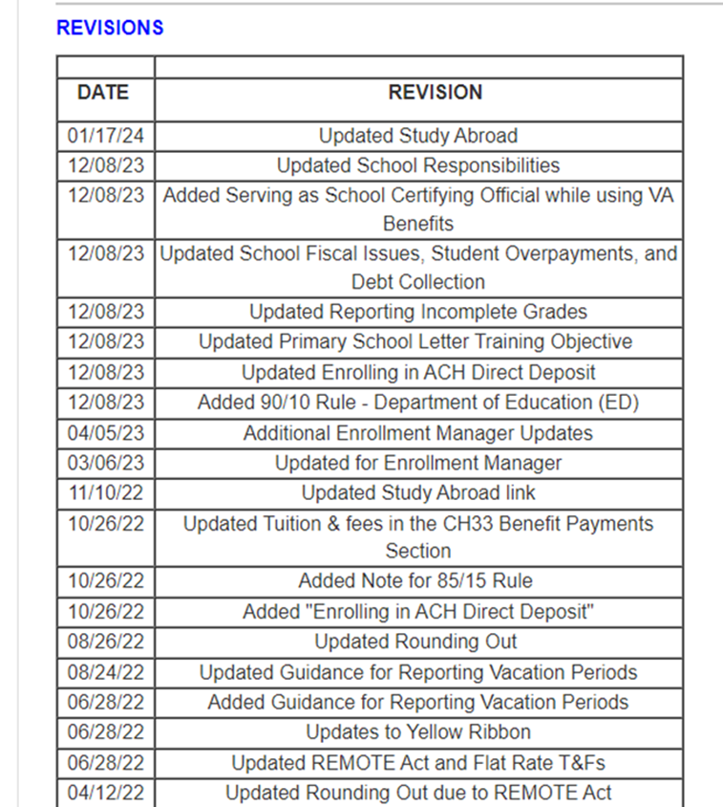
SCO Handbook Updates
VA updated SCO ratio to 1 full time SCO for every 125 GI Bill students and/or dependents enrolled in the education institution.
Remedial and deficiency courses offered in an online or hybrid format cannot be approved for VA benefits and cannot be certified to VA under any chapter.
Dual Enrollment-Dual majors pursued under an academic policy that defines the dual major’s requirements can be certified if both majors are approved.
A combination of two approved degree programs at the same school does not need additional approval.
Study Abroad-The student must be enrolled in courses that will apply to their degree program (approved program for VA purposes).
The courses must be leading to a standard college degree or the equivalent and apply to their degree program
The foreign institution must be approved by VA

Slide 4
85/15 Rule
What is the 85/15 Ratio Requirement?
The 85/15 Ratio Requirement prohibits paying Department of Veterans Affairs (VA) benefits to students enrolling in a program when more than 85% of the students enrolled in that program are having any portion of their tuition, fees, or other charges paid for them by the school or VA.
If the ratio of Supported Students to Non-Supported Students exceeds 85% at the time a new VA beneficiary student enters or reenters (such as after a break in enrollment), the student cannot be certified to receive benefits in the program.
New Requirement removes exceptions
Waiver application
Notes:
In response to any concerns that such schools would be unfairly placed in noncompliance with the 85/15 rule by operation of this rule, VA notes that whenever an educational institution exceeds the 85 percent limit, it may apply for a waiver of the 85/15 rule under 38 CFR 21.4201(h). Accordingly, VA is amending section 21.4201(h) to allow an education institution to demonstrate that although its program is in violation of 85/15, its non-VA scholarship recipients are effectively serving as market validation, and, therefore, continued enrollment of new VA education beneficiaries is nonetheless in the best interest of the students and the Federal government. Consequently, the elimination of section 21.4201(e)(2) does not mean that all generous schools will be eliminated from the GI Bill. It merely means that, on a case-by-case basis, a well-intentioned generous school could be granted a waiver while simultaneously limiting the potential for miscalculations and misapplication of scholarship information, whether intentional or unintentional.

Slide 5
Federal Register language on 85/15 new guidelines
In response to any concerns that such schools would be unfairly placed in noncompliance with the 85/15 rule by operation of this rule, VA notes that whenever an educational institution exceeds the 85 percent limit, it may apply for a waiver of the 85/15 rule under 38 CFR 21.4201(h). Accordingly, VA is amending section 21.4201(h) to allow an education institution to demonstrate that although its program is in violation of 85/15, its non-VA scholarship recipients are effectively serving as market validation, and, therefore, continued enrollment of new VA education beneficiaries is nonetheless in the best interest of the students and the Federal government. Consequently, the elimination of section 21.4201(e)(2) does not mean that all generous schools will be eliminated from the GI Bill. It merely means that, on a case-by-case basis, a well-intentioned generous school could be granted a waiver while simultaneously limiting the potential for miscalculations and misapplication of scholarship information, whether intentional or unintentional.
Notes:
In response to any concerns that such schools would be unfairly placed in noncompliance with the 85/15 rule by operation of this rule, VA notes that whenever an educational institution exceeds the 85 percent limit, it may apply for a waiver of the 85/15 rule under 38 CFR 21.4201(h). Accordingly, VA is amending section 21.4201(h) to allow an education institution to demonstrate that although its program is in violation of 85/15, its non-VA scholarship recipients are effectively serving as market validation, and, therefore, continued enrollment of new VA education beneficiaries is nonetheless in the best interest of the students and the Federal government. Consequently, the elimination of section 21.4201(e)(2) does not mean that all generous schools will be eliminated from the GI Bill. It merely means that, on a case-by-case basis, a well-intentioned generous school could be granted a waiver while simultaneously limiting the potential for miscalculations and misapplication of scholarship information, whether intentional or unintentional.

Slide 6
Checklist for Supported/Non-Supported Students
https://benefits.va.gov/GIBILL/85_15/Supported_Non_Supported_Students.asp

Slide 7
Enrollment Manager Updates
Enrollment Manager system updates webpage
CH35 Students- parent name required-if not known, use Source One in both name fields
Enrollment Manager User Guide – download
Dual Degree Enrollment guidance-add VBA remark

Slide 8
SCO Handbook Legislation
State Approving Agency (SAA) allowed to conduct compliance and risk-based surveys (PL 115-048, Harry W. Colmery Veterans Educational Assistance Act of 2017, Section 310).
Department of VA with SAA to develop a comprehensive program to conduct risk-based surveys and establish a searchable database (The Johnny Isakson and David P. Roe Act of 2020 (Public Law 116-315) Section 1013).
All records and accounts of schools pertaining to Veterans and eligible persons, as well as the records of other students that are necessary to determine compliance with the law, must be available for examination (38 U.S.C. 3690(c) and 38 CFR 21.4209).
https://www.knowva.ebenefits.va.gov/system/templates/selfservice/va_ssnew/help/customer/locale/en-US/portal/554400000001018/content/554400000149088/School-Certifying-Official-Handbook-On-line

Slide 9
State Approving Agency
Uniform Catalog Approval/Re-Approval application
Submit as PDF to saa-apps@milvets.nc.gov
List ALL programs up for approval/re-approval. If a program is not listed on the required form, it will not be approved/re-approved.
Supporting Documentation to include in your submission:
Accreditation Letter (current letters only)
Advertisements
Catalogs/Publications
Department of Education Program Participation Agreement
Template of facility’s Shopping Sheet/Financing Plan
Title 38 US Code 3679 subsection (e}, this school adopts the following additional provisions for any Chapter 31 and Chapter 33. This school will not:
· Prevent the student’s enrollment;
· Assess a late penalty fee to;
· Require student secure alternative or additional funding;
· Deny their access to any resources

Slide 10
Risk Based Survey Objectives
1. Provide a mechanism for VA and SAA’s to review and mitigate potential fraud, waste, and abuse by utilizing data and risk factors.
The following are legislatively mandated risk factors.
a. Rapid student population increase
b. Rapid tuition and fee payment increase
c. Volume and severity of validated student complaints
d. 85/15 rule violations
e. Veteran completion rates
f. Financial stability
g. Advertising and marketing
h. Federal or State government actions in court
2. To verify the propriety of educational benefits paid to ETIs on behalf of eligible individuals under the provisions of the laws administered by VA.
3.Assure prompt action is taken if risk factors and associated practices are substantiated.

Slide 11
Time Frame for Risk Based Surveys and Compliance Surveys
SEC. 12. NOTICE REQUIREMENTS FOR DEPARTMENT OF VETERANS AFFAIRS EDUCATION SURVEYS.
(a) Risk-Based Survey.—Section 3673A of title 38, United States Code, is amended by adding at the end the following new subsection:
“(d) Notice.—To the maximum amount feasible, the Secretary, or a State approving agency, as applicable, shall provide not more than one business day of notice to an educational institution before conducting a targeted risk-based survey of the institution under this section.”.
(b) Compliance Surveys.—Section 3693 of title 38, United States Code, is amended—
(1) by redesignating subsection (c) as subsection (d); and
(2) by inserting after subsection (b) the following new subsection (c):
“(c) To the maximum extent feasible, the Secretary, or a State approving agency, as applicable, shall provide not more than 10 business days of notice to an educational institution or training establishment before conducting a compliance survey of the institution or establishment under this section.”.

Slide 12
Preparation for Reviews
Clarification of required documents
List of students using benefits and one student not using VA educational benefits
Document based review
Collaboration with other departments
Availability of other departments on day of visit

Slide 13
Parts of Risk Based Survey
Request for information
ETI Specific Data
ETI Specific Information
Current Numbers
Financial Soundness Review
Advertising documents
Complaint Documents
Student Documents
On Site visit

Slide 14
SCO Document Upload Portal
https://www.my.va.gov/EducationFileUploads/s/
VA uses a document upload portal to assist SCOs in sending common documents. Some common documents which can be sent through the portal include:
Compliance documents requested to support a scheduled compliance activity at your institution. You will need the Unique ID provided by the survey specialist to upload the requested documents.
VA Form 22-8794 – Designation of Certifying Officials with training certificate(s).
EFT and Tax ID Update Must be on organization letterhead.
VA Form 22-10216 with VA Form 22-10215 – 35% Exemption & 85/15 reporting.
VA Form 22-10215 – 85/15 reporting documents may include VA Form 22-10215a.
VA Form 22-10216 – 35% Exemption Request.
VA Form 22-1919 - Conflicting Interests Certification for Proprietary Schools
VA Form 22-0831 – List of Affected Branches/Extensions for Centralized Certification.

Slide 15
DOD MOU Compliance
Confirm contacts on DOD compliance website
https://dodvoled.experience.crmforce.mil/CRMTool/s/login/?ec=302&startURL=%2FCRMTool%2Fs%2F
Self Assessment
Evidence of compliance
Website links
Documents
Keep access to compliance website active
Renewal up to 180 Days prior to expiration

Slide 16
DOD Self Assessment and Feedback
Contact DOD and ask questions- email or phone
We had findings that were incorrect
Collaboration from other departments
Job descriptions
Website updates

Slide 17
DOD Corrective Action Plan
Detailed plan to correct findings
If information has already been sent, respond with no action will be taken since we are in compliance based on either response from DOD or based on review of information sent in original self assessment
School has 4-5 months to correct findings
Plan for time to collaborate with other departments to make necessary updates

Slide 18
DOD Evidence of Remediation
Upload evidence of corrected information
Automatic email that evidence has been uploaded
Confirm DOD VolEd dashboard reflects evidence has been sent

Slide 19
QUESTIONS

Slide 20
The End

Slide 22
Federal Tuition Assistance

Slide 24
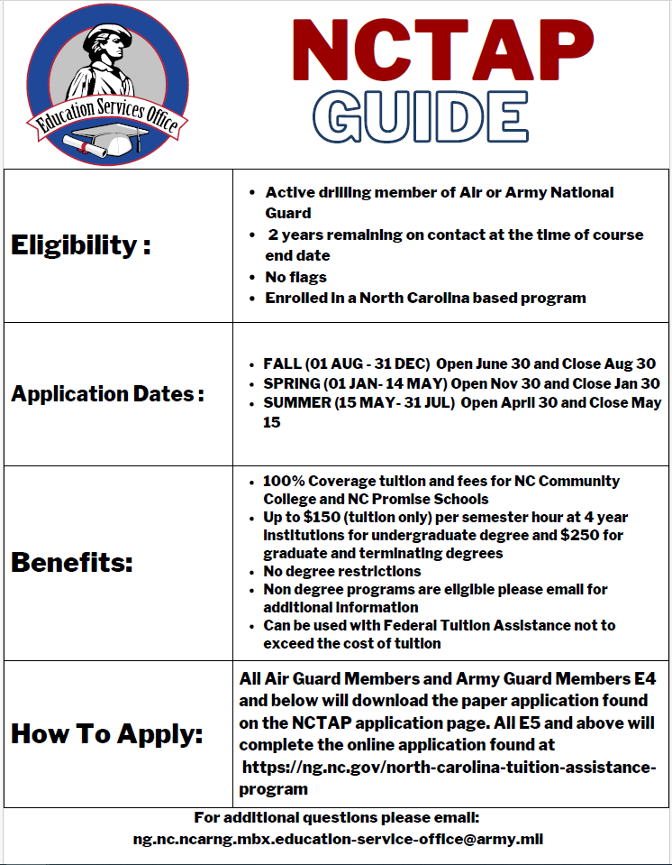

Slide 25
NC National Guard Education Services

Slide 28
Compliance Survey From Handbook
(1) ensure that VA payments going to the school and students enrolled at the school are based upon proper and correct enrollment information as furnished by the school to VA; and,
(2) assist school and training officials and students in understanding the requirements of the law in order to prevent deficiencies or violations which could develop because of misunderstandings or misinterpretations of the law.
Occasional remote survey options are available.

